Slide 1


Canada 150
Walk on the Wildside: 20+ events across the province
Photo competition: 100 entries 3500+ saw exhibit
Art Show: 100 pieces of art 2200+ saw exhibit
Social Media: tens of thousands of NEW engagements
Canada 150 Land Trust Honour Roll: individuals who have made a difference during LTABC’s 20^{th or} in 2017
THANKS!!!!!!!!!!!!!!!
Boards: LTABC / LTC Program: Christine Torgrimson, Dave Cunnington, Jennifer Eliason
Sponsors: Gosling Foundation, Conservation Fund, Real Estate Foundation, HCTF, The Emporium and The Marriot
Special thanks: Renata Woodward, Denise Nicholls, Erika Bland
YOU!!!!!!!!!!!

Slide 2
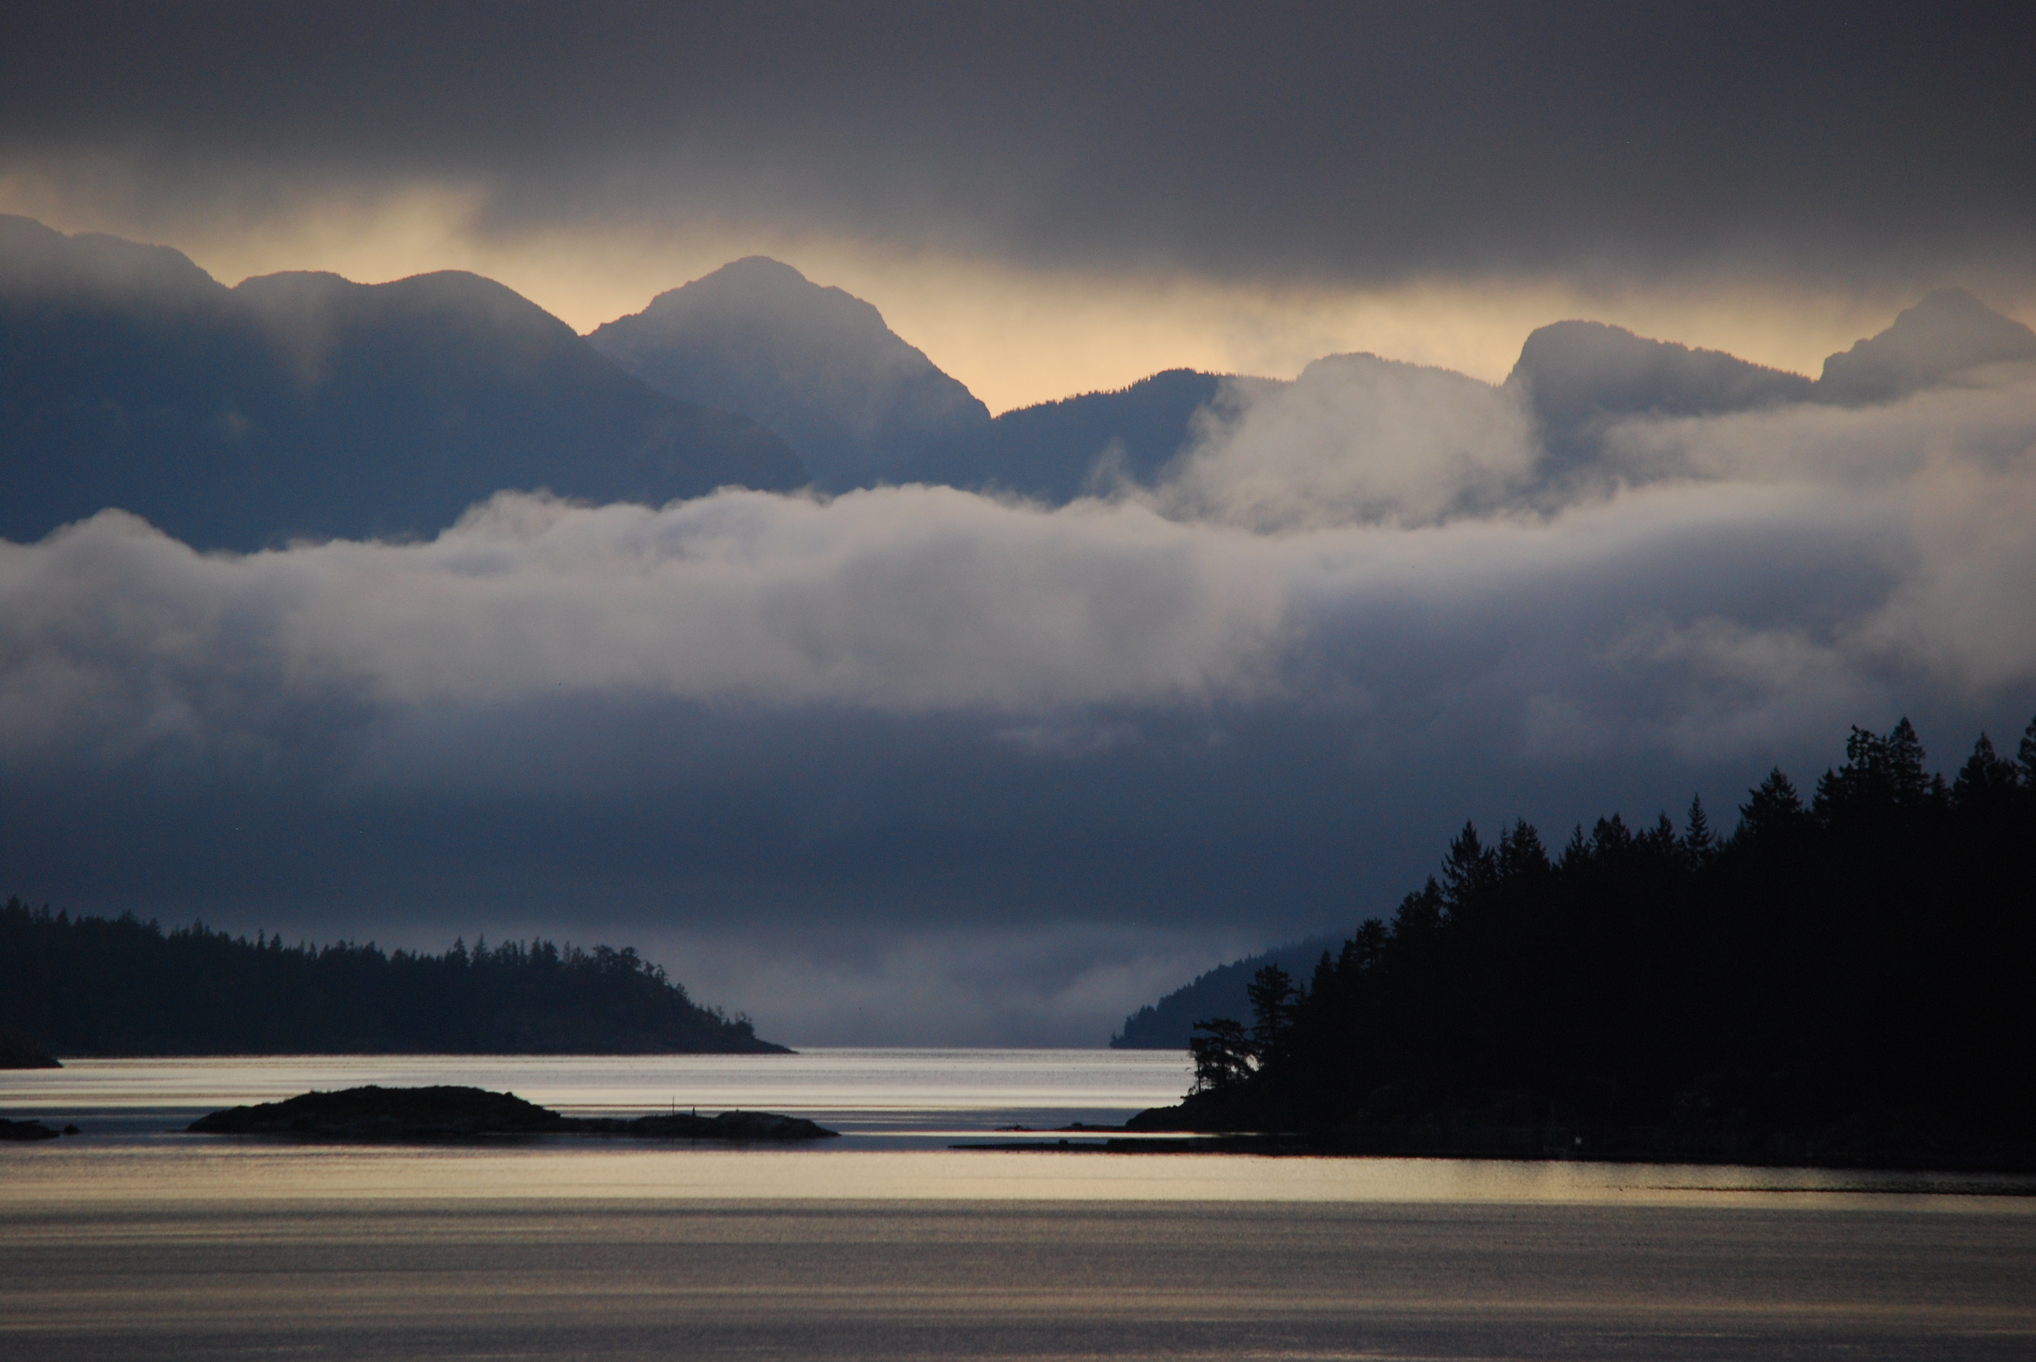
Land Trusts Canada
Land Summit 2017
VICTORIA
East Coast Cortes Island
Helen Hall

Slide 3
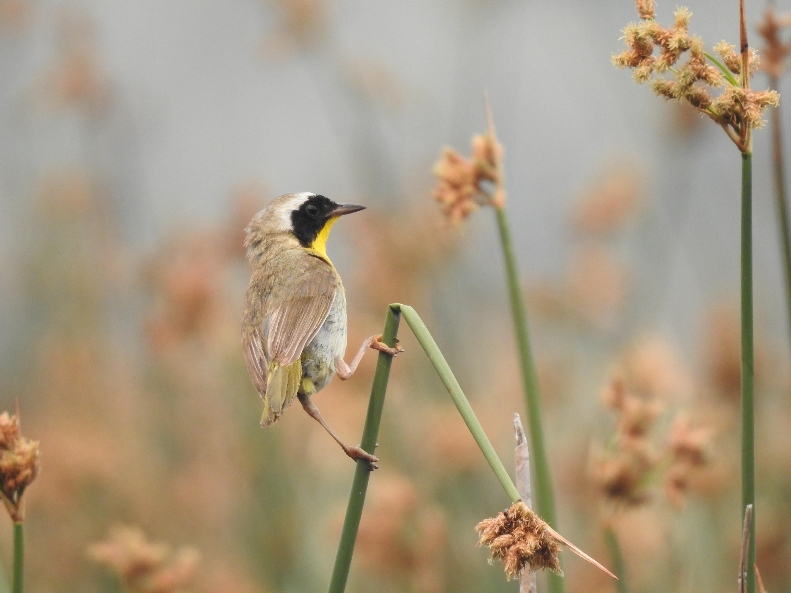
Land Trusts Canada
CLTA discussions 2009 to 2011 – meetings, facilitators, proposals without agreement
2014 OLTA called LTABC with a renewed interest in national presence
2015 OLTA RMN LTABC met in Toronto at NCC office and drafted MOU
MOU outlined areas of mutual interest: education, S&P, data collection, marketing and services

Slide 4
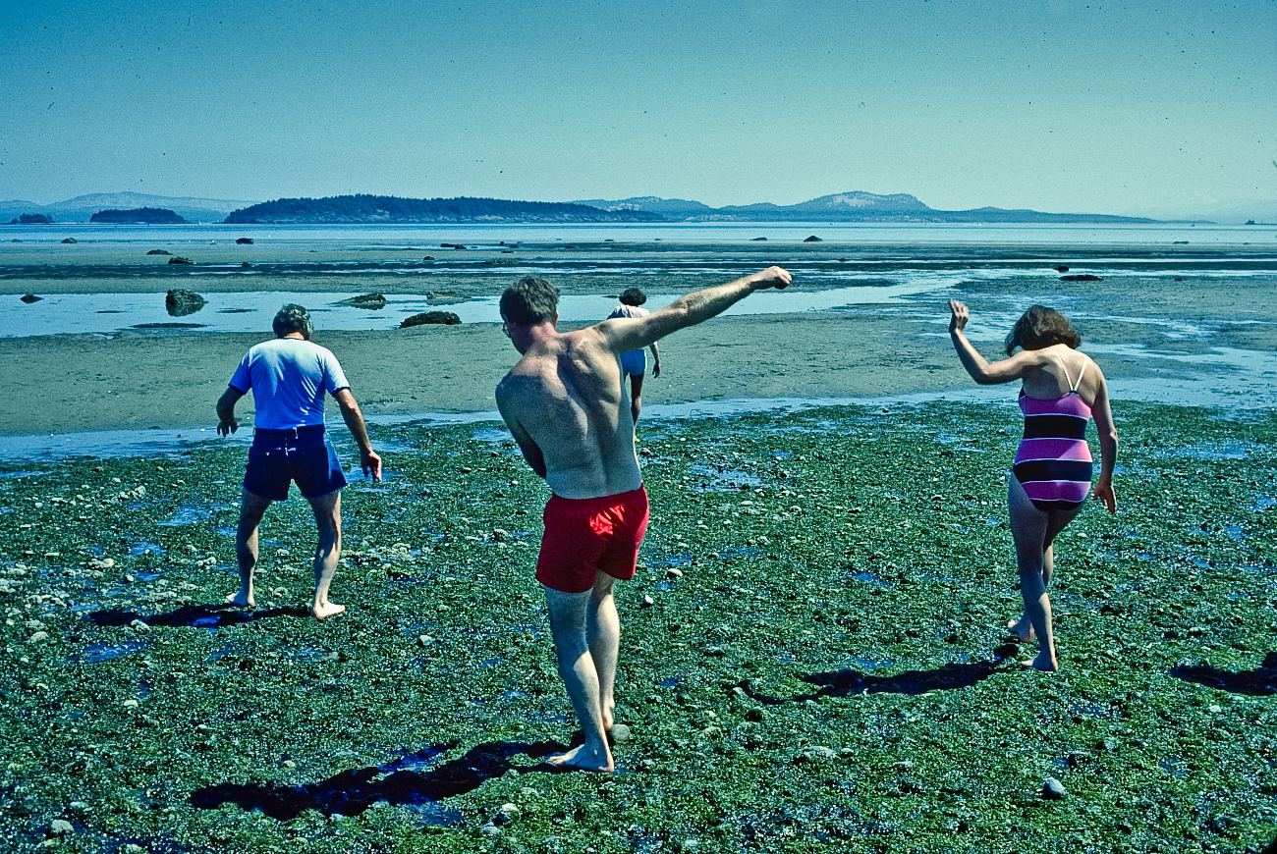
MOU followed by national survey with 40%+ response of 132 land trusts spec about national org
2016 OLTA spearheaded a draft business plan and strategy based on the areas identified in the MOU
2016 national land trust survey: Karen Kalynka (land trust data)
The plan identified two additional regions – Atlantic and Western and in discussions were added to the working group

Slide 5
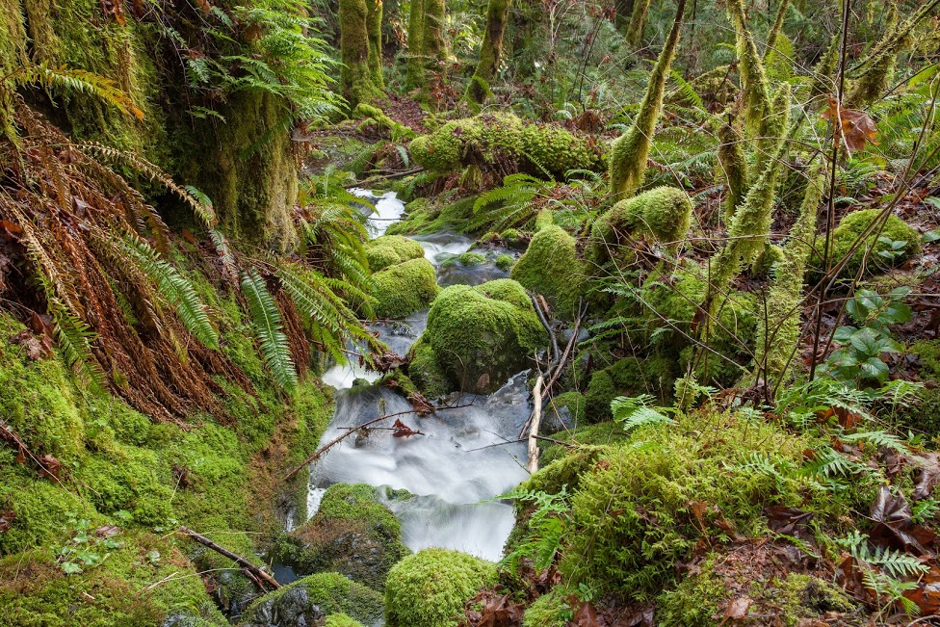
Land Trusts Canada
2017 – bylaws drafted and federally incorporated as nonprofit August 2017
The bylaws cover basic admin and governance with main governance specification:
FIVE regions each with TWO representatives
Atlantic Quebec Ontario Western BC
Where there are Alliances that group will facilitate the two reps, in other regions a “caucus” approach will select representatives. There is also a provision that a nation rep will be on the Board rotating between organizations.

Slide 6
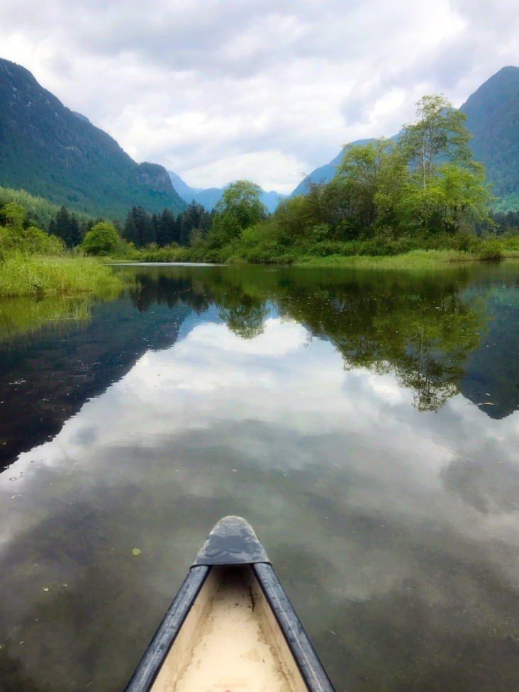
2017:
Discussions with Director General and Staff at Environment Canada
Several letters sent to Minister including support for NACP
Discussion with CLTA on S&P with future discussions on that program and org structure
Discussions with funders
Conference S&P, reps from all regions, elevated learning opportunity

Slide 7
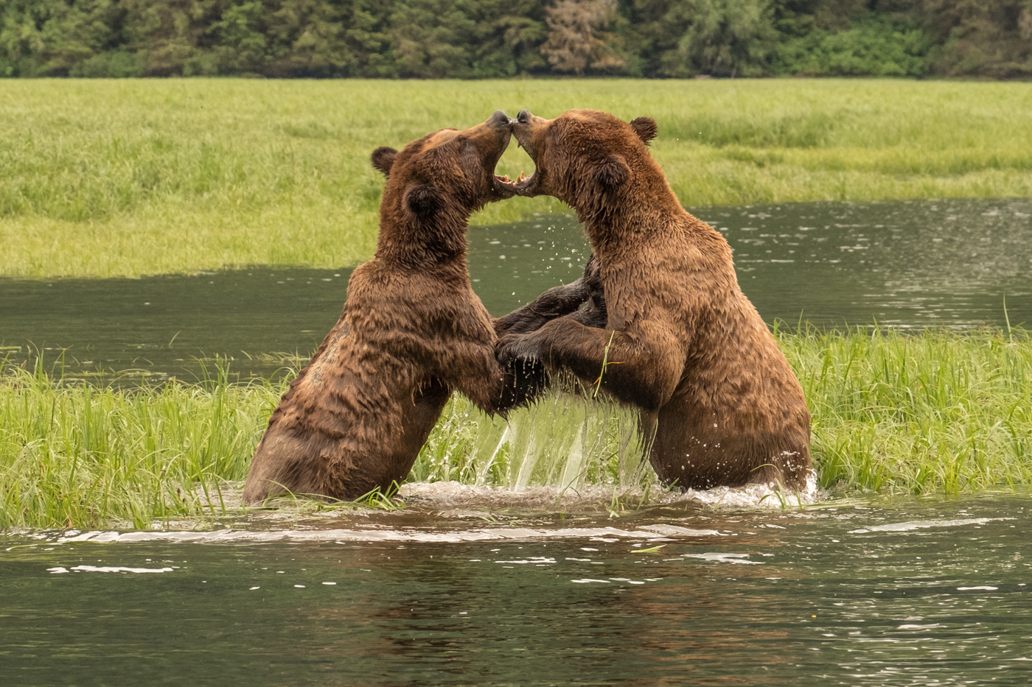
Land Trusts Canada
2017-2018
Continued discussions with CLTA
Discussions with EC
Discussions with funders
Second national conference
Launch of website
Charitable status
Staff

Slide 8
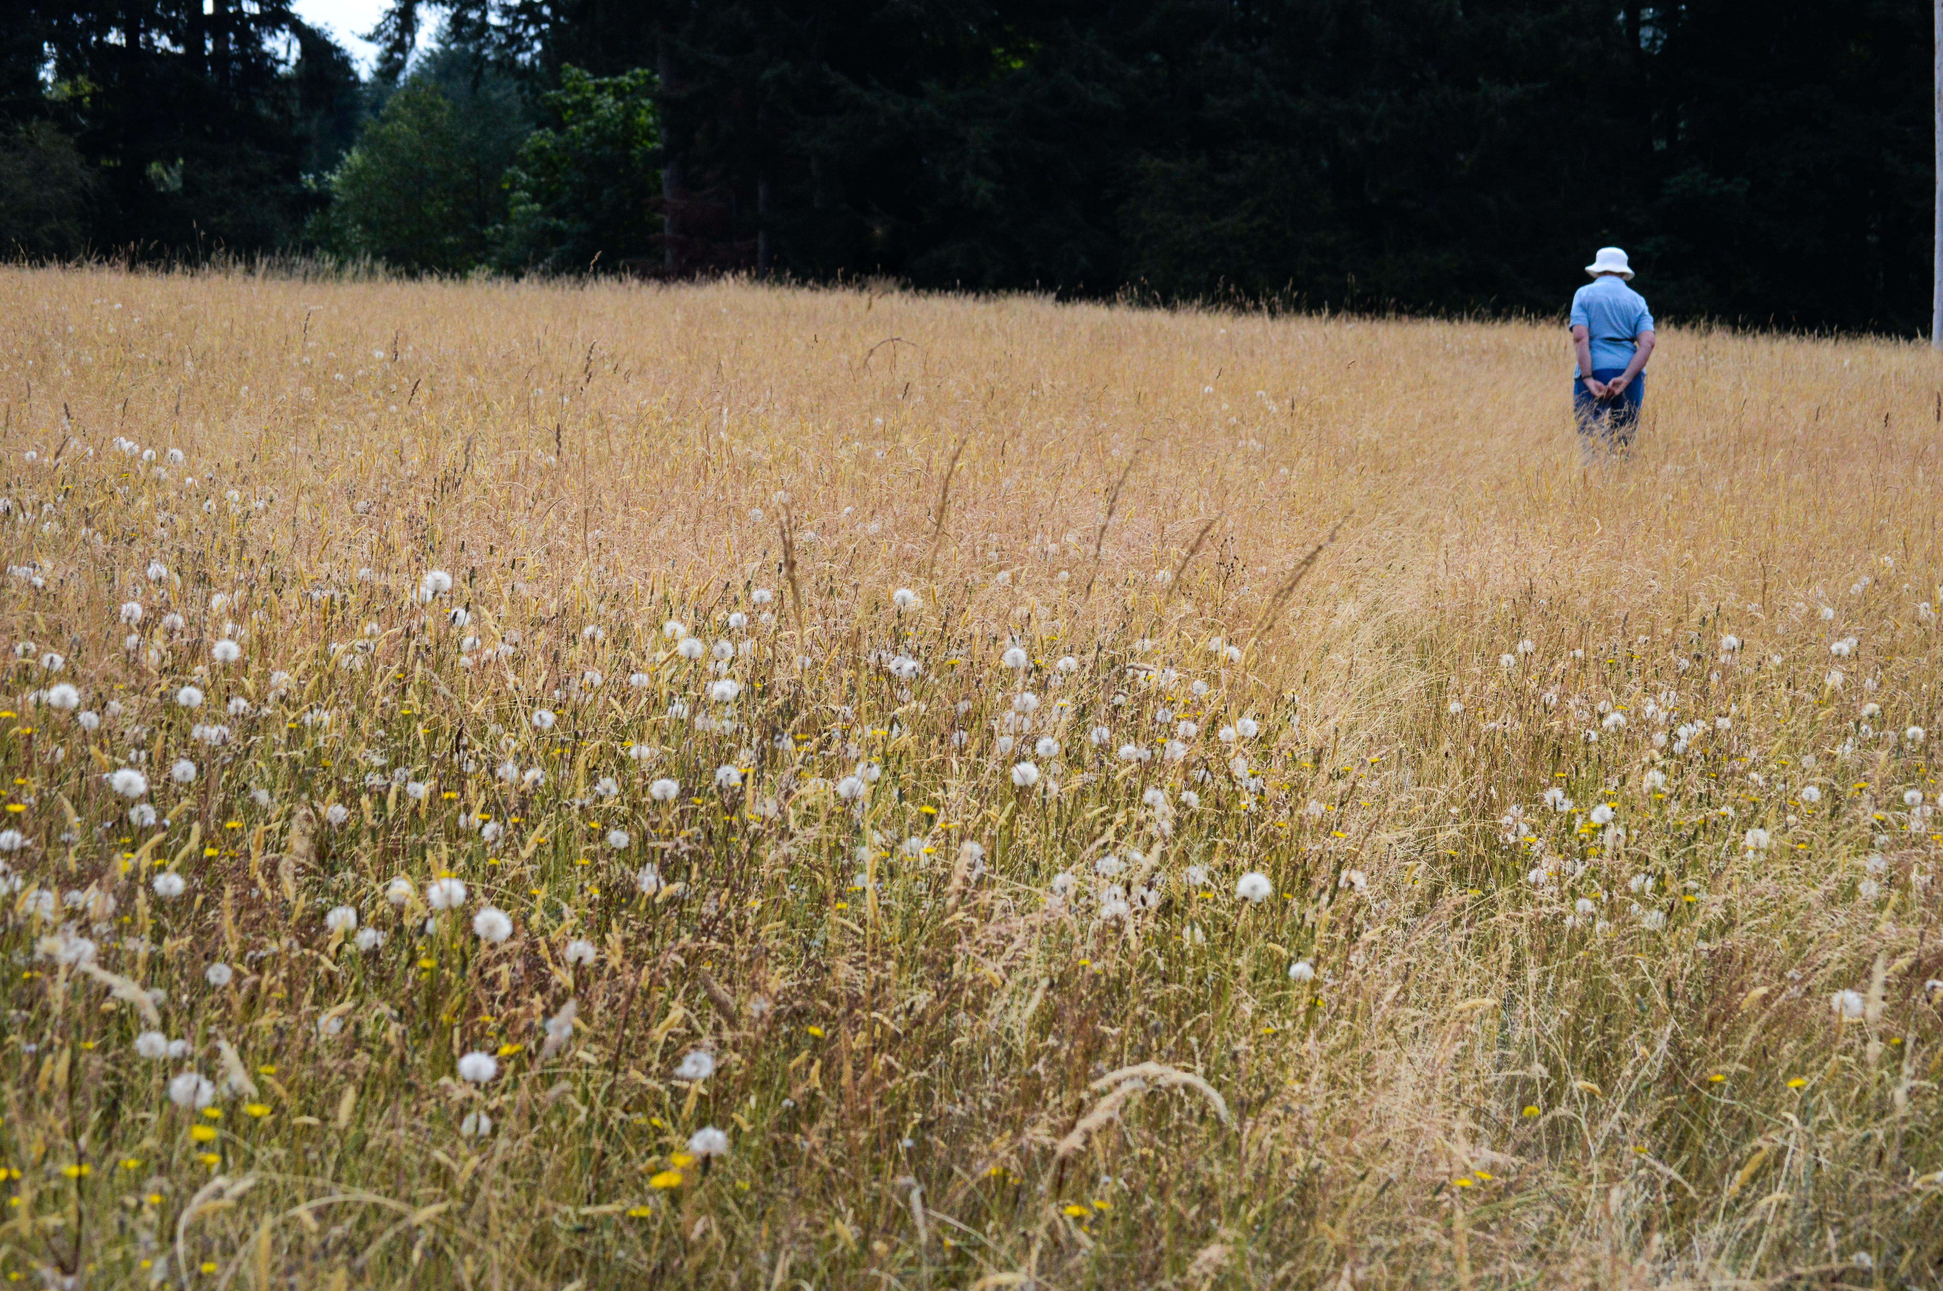
Questions:
Share your thoughts on the relevance of a national organization
Discussion on the membership structure of a national organization

Slide 9
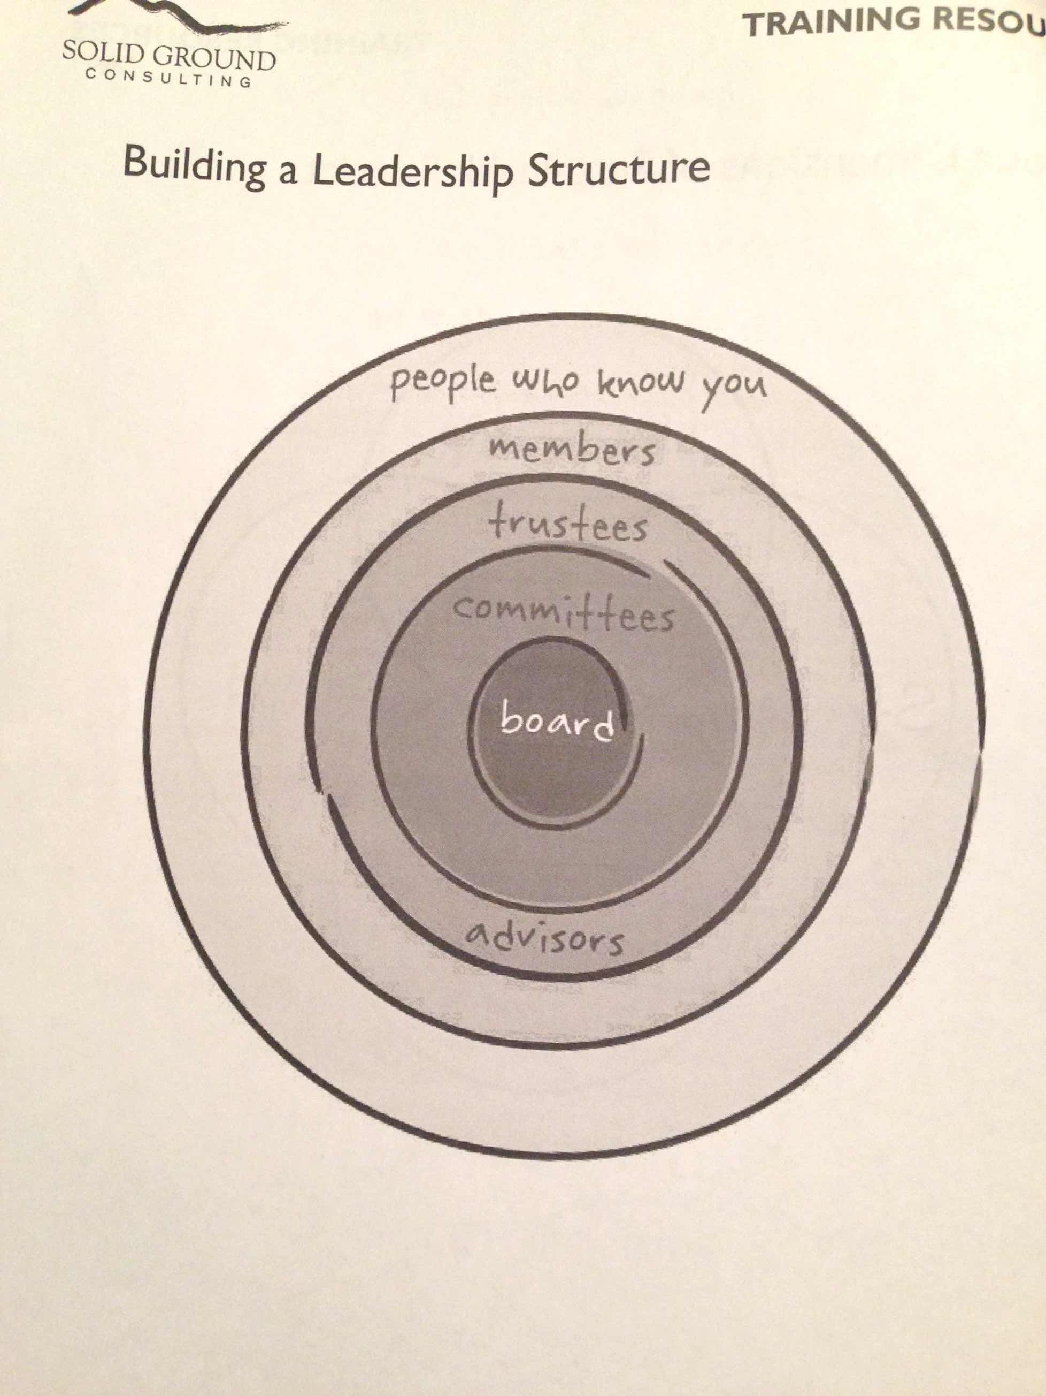
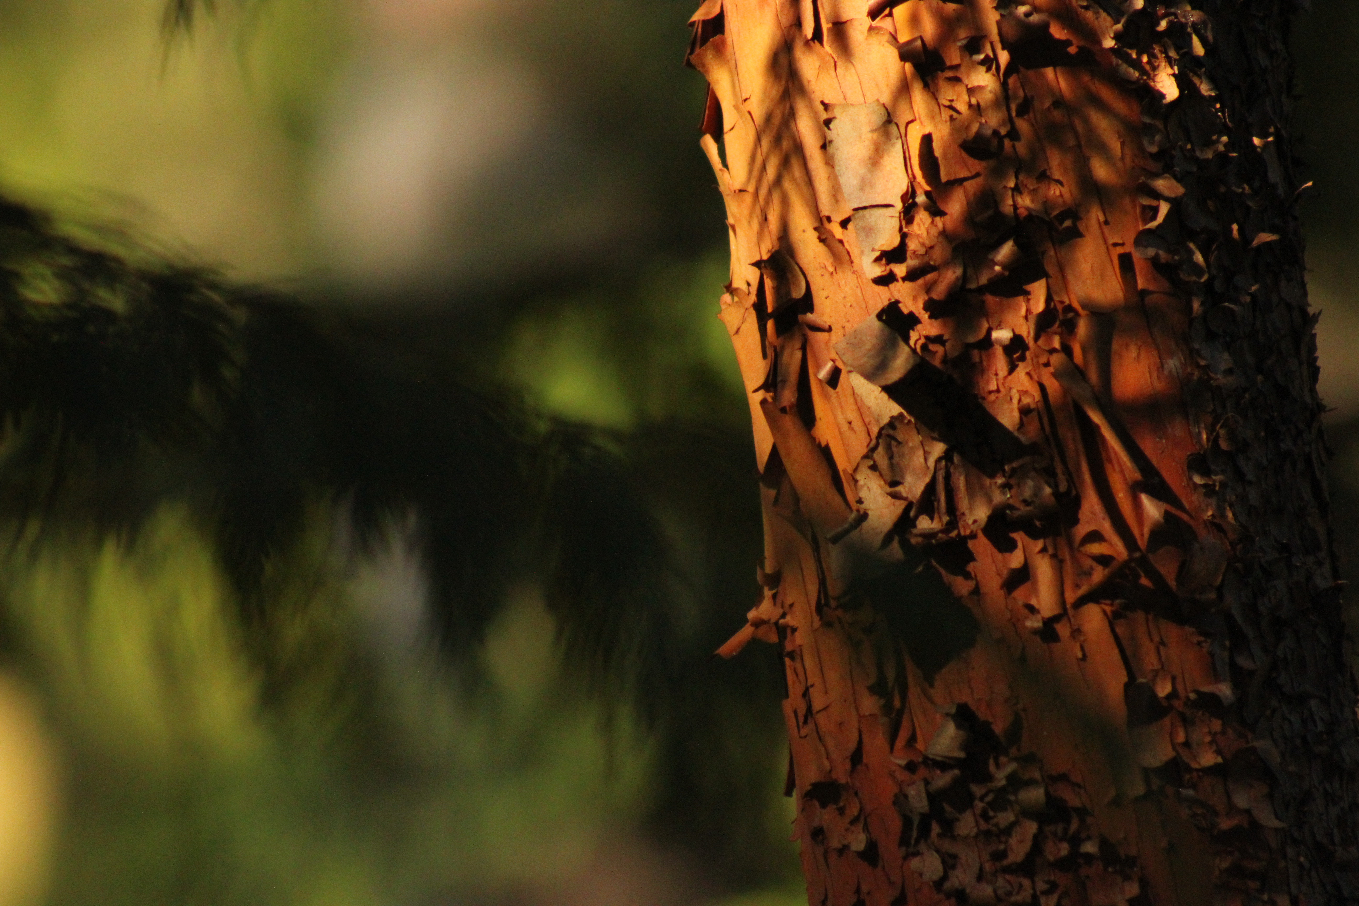
Board (working group)
how do we engage and
communicate with land trusts
and is there an interest in an
engagement committee
(LT support, public conservation
pledge and fundraising)

