Slide 1

Terrafirma Risk Retention Group Lessons Learned and
National Perspectives
For the 2021 Conference
Land Trust Alliance of
British Columbia
Notes:
I am delighted to be with you Thank you for your interest in lasting conservation

Slide 2
Six Points About Terrafirma
Owned by the insured member land trusts.
Covers preserves, trails, covenants and easements.
Provides conservation defense liability insurance.
Serves as a safety net for all costs of covered claims.
Organized as a Risk Retention Group.
Nothing else like it in the world.
Notes:
Confidence is critical. land trust leaders report that in a dispute they have let the parties know that the land trust has special insurance backing them.
That changed the dynamic and sometimes settled the dispute.
For those disputes that do go to court, Terrafirma gives the land trust the resources to stand in and prevail in a long fight.
Just two points here that I want to emphasize: the land trusts own Terrafirma – no one else does; and Terrafirma covers your entire conservation portfolio, including preserves and trails and deed coveantns
Next slide

Slide 3
2021 Terrafirma Stats
9,788,482 Acres insured
538 Land trust members
34,686 Insured parcels
1184 Official claims total 3-1-13 to 2-8-21
3.5 Million dollars paid over 3-1-13 to 2-8-21
Notes:
Terrafirma started in 2013 with 42
8 land trust members insuring 6,354,434 million acres. The steady growth indicates members’ commitment to lasting conservation.
Total paid claims per member in 2020 is about $5405 each
Total paid divided by all claims is about $2851.00 but the average covered claim costs about $33,000 to resolve. And you never know in advance which problem is going to cost $100,000 (3) or $300,000 (1) or $500,000 (2) or more to resolve.
last slide

Slide 4
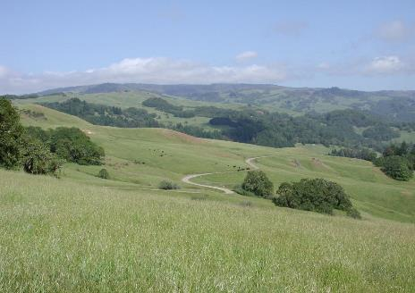
Agenda
Lessons Learned
National Perspectives
Developments on drafting USA easements
  Modifications
  Building Rights
  Approval Standard
  Commercial Forestry
Notes:
Let’s get going as we only have a half hour. Due to the limited time, I will not take questions but please do call or write to me. I am delighted to talk with you.
These are the two categories that we will discuss today. I won’t follow your handout exactly and I wont be able to touch on everything however I hope botht he handout and the slide deck will assist you throughout your class work.

Slide 5
Lessons Learned
Disputes and Court
Owned land and preserves
Costs and Fees Recovery Clause in CE
Division of land prohibition
Documentation
Notes:
Let’s get going as we only have a half hour. Due to the limited time, I will not take questions but please do call or write to me. I am delighted to talk with you.
These are the two categories that we will discuss today. I won’t follow your handout exactly and I wont be able to touch on everything however I hope botht he handout and the slide deck will assist you throughout your class work.

Slide 6
Take Aways
Be prepared to lose at trial court.
Major violations cases are rare.
Rate of violations are relatively steady.
Problems with original landowners are up.
Position the land trust to prevail with solid drafting and strong stewardship.
Preserves have problems too!
Notes:
Or to be disappointed by some aspect of the result. That means that land trusts must have the resources and resolve to persevere.
CE holders (both governments and land trusts) win the vast majority of violations cases litigated – sometimes it takes an appeal to do it.
The Taylor case from Ohio is an excellent example of losing in a probate court partition proceeding and prevailing soundly on appeal in a challenge involving original landowners.
(Violations and preserve trespass are rising, with increasing number of easements, owned land and increasing successor owners.)

Slide 7
Take Aways
Preserves have problems too! Action steps:
Manage with a board liaison and full board authority
Take immediate proportional steps with clear goals
Use neighbor eyes
Implement proactive mitigation
Retain appropriate local counsel
Confirm insurance coverage
Have exceptional documentation
Have a strong damages theory
Have written policies and procedures
Notes:
Interview neighbors or potential witnesses (a land trust may consider contacting the local police as a part of this process);
Photograph the encroachment;
Document the encroachment’s precise location and aerial extent using GPS/GIS technology;
If the encroachment involves significant tree or shrub felling, hire a forester to appraise the loss using The Guide for Plant appraisal, as published by the International Society of Arboriculture, Urbana, Illinois, or a succeeding publisher; http://www.isa-arbor.com/store/product.aspx?ProductID=93
Send a certified letter to the encroaching party notifying it of the violation and the obligation to restore the property and to inform their insurance carrier of the claim; and
If the land trust does not receive a response to the letter or the response inadequately ensures the restoration of the property, call counsel.
.
Be diligent and resourceful

Slide 8
Take Aways
Have a strong costs and fees recovery clause in your easement.
Judges hate to award costs and fees even if you have a clause.
Judges will narrowly interpret your clause to avoid awarding costs and fees.
Your job is to make it impossible to do anything but award the land trust its costs and fees.
Notes:
Almost all of the time the land trust does not recover any of its costs and fees. Happily, Larry’s dispute was one of the exceptions but it was a long hard slog to get there and the trespasser called on his insurance coverage to pay for it.
Pointers on CE Drafting – please give this to your attorney and your board committee then tune up your template. It has among others, costs and fees clause based on what judges said in court opinions, a comprehensive no division clause, and so much more to enhance your base template
The WY case in your handout is a classic example of winning on the substantive issue (which is the first essential) but totally losing on recovery of costs and fees due to a too narrow recovery clause in the CE.
Judicial subjectivity plays a big role, both positive and negative. So your attorney must understand the court systems and the perspective of each individual judge
Next slide

Slide 9
Take Aways
Partition of tenancy in common
Foreclosure of mortgage encumbering part of easement property
Tax foreclosure of part of easement property comprised of multiple tax parcels
Bankruptcy rejection of executory contract
Landowner adjusting boundaries unilaterally
Long term leases of only a portion of the property
Notes:
We are seeing prohibited division problems with both original grantors and successors
Can be expensive and time consuming to reverse
Best to catch it before
Must have a wide and deep comprehensive prohibition clause

Slide 10
Take Aways
Documentation is fundamental and critical.
Annual monitoring both fee and CE.
Written annual report, maps and photos.
Remote monitoring is an option.
Full complete and consistent baseline.
Consistent timely file memos, notes and correspondence for approvals, modifications, boundaries, disputes and resolutions.

Slide 11
National Perspectives
Owned land (preserves)
Types of Disputes
Challengers
Costs by Challenger
Cost compared to duration
Notes:
Let’s get going as we only have a half hour. Due to the limited time, I will not take questions but please do call or write to me. I am delighted to talk with you.
These are the two categories that we will discuss today. I won’t follow your handout exactly and I wont be able to touch on everything however I hope botht he handout and the slide deck will assist you throughout your class work.

Slide 12
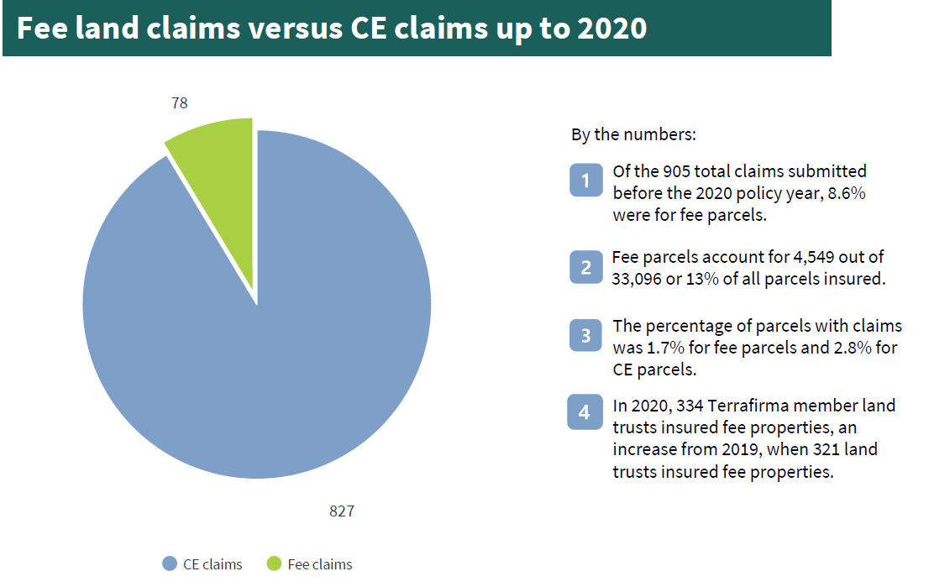
Notes:
While CE claims still run ahead of owned land claims, the percentage is still significant for costly trespass on preserves
Next slide

Slide 13
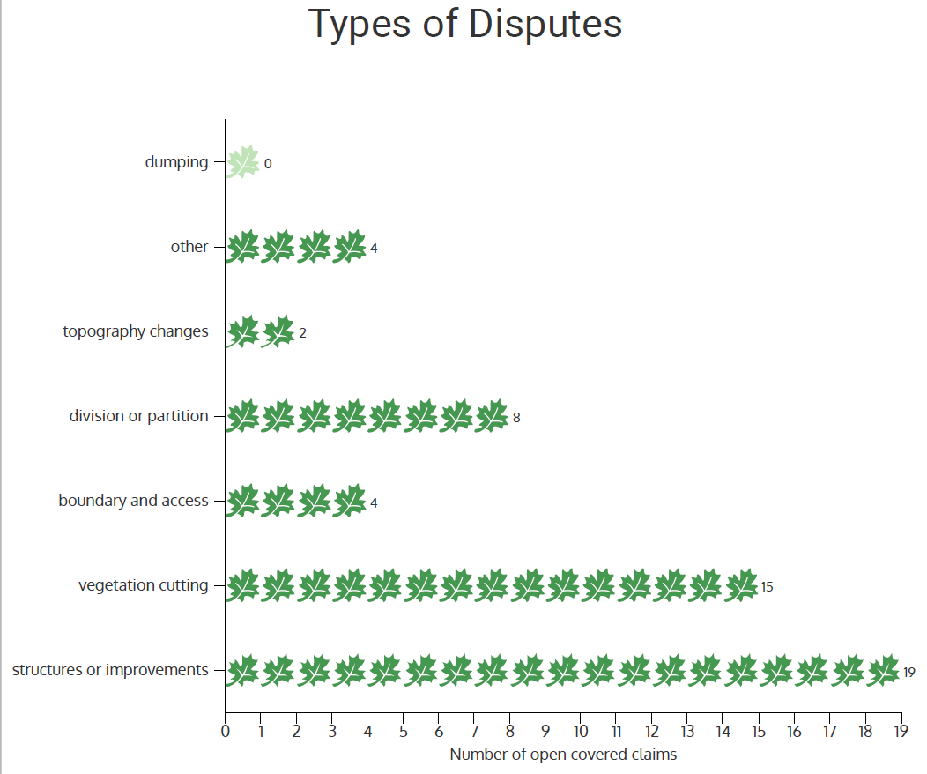
Notes:
I think this is no surprises on structures and improvements (usually roads and drives) being the top violation and preserve trespass followed by vegetation cutting .
Resolving some of the roads and vegetation cutting cases has been surprisingly expensive.
Terrafirma’s two full claims loss cases both involved significant tree removal and construction of prohibited roads
Structures and improvements mostly seem to be access roads, driveways and nonresidential structures outside of envelopes or that are fully prohibited
A consistently big problem with enforcing CEs on vegetation cutting and structures is drafting clear comprehensive clauses and also ensuring that other clauses such as permitted forestry or permitted ag structures do not undercut enforcement of the limited or prohibited clauses.
Next slide

Slide 14
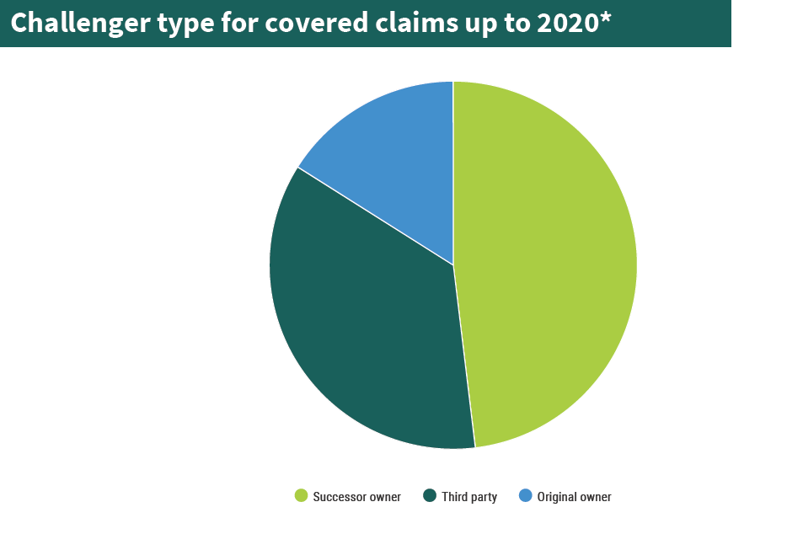
Notes:
You can see that third party challenges (trespass) is almost as much as CE successor owner violations. This data point also includes neighbor trespass on CE land.
Original landowners are making themselves felt as CE challengers.
Next slide

Slide 15
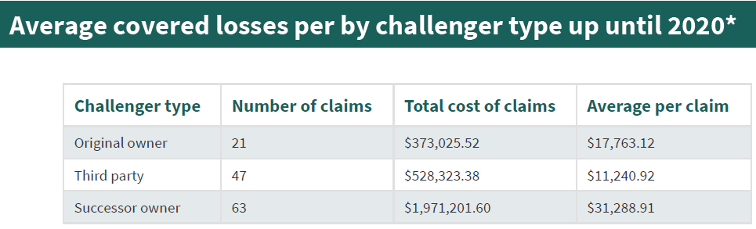
Notes:
You can see that it is still successor owners that cause the most expensive claims by a wide margin.
And within that category the very most expensive cases are driven by well funded successor owners (sometimes neighbors) who want to win at any cost
Some of the cost can be attributed to the land trust delay in shifting gears because they hoped to resolve the matter and did not recognize the warning signs
Next slide

Slide 16
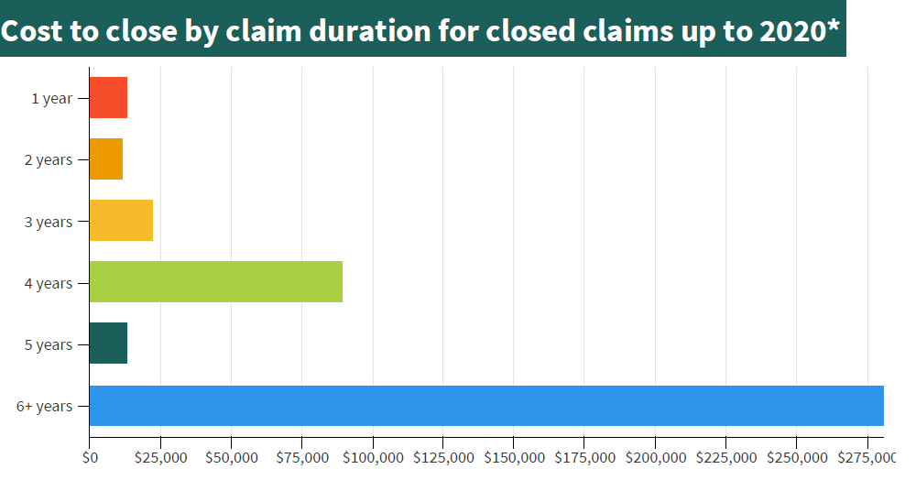
Notes:
It is much less expensive to tackle these fast and resolve them early
Neighbors and successor owners with means and a limitless will to win are the mostly likely to run 4 years or more and cost $100,000 or more to resolve
Next slide

Slide 17


Developments on drafting from tax cases
Risk Balancing
Notes:
In its quest to eliminate grossly overvalued deductions, the tax court sadly has distorted and overreached on its interpretation of the Code and Regulations with sometimes serious adverse impacts to conservation. The short take aways are
Amendment clauses are consistent with perpetuity however the IRS appealed the decision. The Alliance filed an appellate brief in favor of sound amendment provisions. See the Drafting Pointers for the elements of a sound amendment clause.
Avoid all fully floating residential building rights; include protective siting provisions. See the building rights drafting pointers for more. The Alliance is pursuing the building rights issues on appeal as the decisions are much too overbroad and misstate the law.
The proceeds clause issue appears to be fixed and supported at the appellate level.
Approval standards, choose either to avoid time limits or use a “deemed denied” standard with time limits. Appeals court upheld the tax court. So this is fixed. The approval standard actually makes sense.
The Alliance hopes that its concerted effort pushing back on the IRS assertion that commercial forestry is contrary to perpetuity has deflected the IRS from pursuing this further or pursing agriculture as inconsistent with perpetuity
For full details read the tax pointers in your handout.

Slide 18
What land trusts care about
Conservation goals and values
Commercial v. noncommercial uses
Temporary v. permanent uses
Implied uses
Notes:
Land trusts focus on conservation impacts

Slide 19
What does the IRS care about?
Perception that the CE favors development rather than protecting conservation first
Perception of self dealing at the expense of taxpayers.
Notes:
The IRS focuses on money and whether it seems that this is a disguised business deal or is “real” conservation. Highly subjective view.

Slide 20
Lessons Learned on CE Drafting
Avoid specific boundary adjustment, building area relocation or land substitution provision in a CE.
Avoid inconsistent or excessive permitted structures and uses.
Address problems and errors through stewardship administration and not an easement clause.
Protect intact blocks of undeveloped land.
Combine conservation purposes and holder’s sole discretion as the approval standard.
Full documentation is critical.
Notes:
This basic list should be of service to you in your CE drafting project. Emphasizing documentation in the CE is an important point.

Slide 21
Examples of non-residential improvements
Agricultural
Recreational
Driveways, roads, fences & parking
Energy & Utilities
Hydrological & Riparian
Signs & Billboards
Construction Related
Mineral Extraction
Notes:
Importance of definitions for all terms such as agriculture, forestry, recreation, improvements, building, building envelope, accessory and incidental and appurtenant, residence, non-residential, commercial. Is a for profit nursing home a residence or a commercial facility? Is a school a commercial activity if there is a tuition charge. Is a school with dormitories residential, commercial or educational.

Slide 22
Define Terms Appropriately
Finding a balance that
defines important terms
doesn’t panic landowners
does keep it simple for stewardship
Define generally accepted meanings
Consider and understand the local zoning code definitions and state law definitions
Do Not rely on law or code definitions
Failure may have serious adverse consequences
Notes:
These risk balancing pointers should provide you some guide rails in your drafting. The big take away here is AVOID ASSUMPTIONS

Slide 23
Improvements and Uses
Improvements and uses typically a reserved or permitted right
  Key decisions are:
  Site, scope, scale, included or excluded?
  Types of improvements, structures and uses?
  Uses limited by family members, employees, home occupations, agriculture, forestry? Stewardship?
  What rights of division? Associated with only residential rights?
  What to control with appropriate stewardship effort? Is the conservation payoff worth the stewardship cost?
Notes:
These additional details should assist you to avoid assumptions and to articulate critical siting points. Remember stewardship!

Slide 24
What Kinds of Cases Did Holders Lose?
Out of 16 total losses:
  2 significant losses
    Orange County Land Trust (NY) ag structures
    Wetlands America Trust (VA) ag structures
  6 minor structures cases
  3 road cases
  1 trail case
  1 vegetation case
  2 division cases (bankruptcy and tax foreclosure)
Notes:
Notice the two ag structures cases in the lost category
Combination of loose drafting, lack of definitions and stewardship miscommunications
I would argue LT’s often overreached in minor structures cases. Thought the CE was clearer that it was. Same goes for road cases.

Slide 25
Final Takeaway
Judicial subjectivity plays a big role, both positive and negative.
  Pointer is to draft so that you limit judicial latitude for subjectivity.
Notes:
Avoid assumptions. Draft like you are writing a court order.

Slide 26
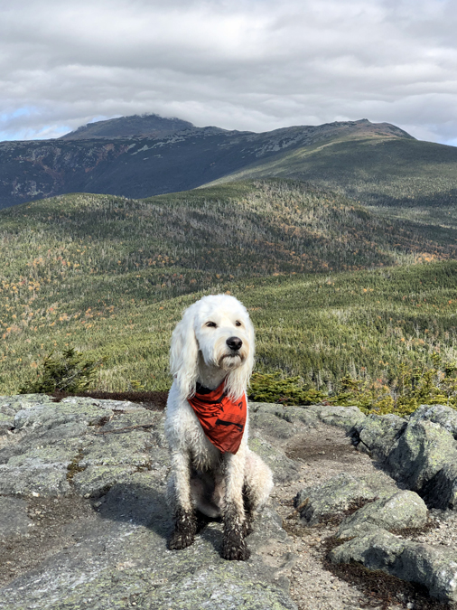
Thank you for your dedication to lasting conservation!
Notes:
Thank you and discussion

