Slide 1

Baseline Documentation Reports:
An Updated Best Practices Template for Conservation Covenants in BC
Tim Ennis
Latitude Conservation Solutions Company
time@telus.net

Slide 2


What is a Baseline Documentation Report (BDR)?
A BDR is defined herein as the “Report” described in a typical Section 219 (Land Title Act RSBC 1996) Conservation Covenant.
It describes the Natural State of the Lands at the time of covenant registration in relation to the Amenities, restrictions and reserved rights.
BDRs are not referenced in the Land Title Act itself.

Slide 3

What is its purpose?
To provide an information baseline specific to the Amenities, restrictions and reserved rights in the covenant, against which all future monitoring will assess compliance in perpetuity.
A BDR is a legal tool specifically designed for the sole purpose of supporting compliance audits.
It protects both the covenant holder and the landowner in case of disputes.
It can have other secondary uses, such as an education or communication tool to new landowners or new Land Trust staff.

Slide 4

How is a BDR different from other kinds of baseline data?
A BDR is very narrowly and specifically tailored to describe the status of the Lands as it relates to the Amenities, restrictions and reserved rights.
These do not always relate to ecological communities, wildlife populations, plant species diversity or the status rank of element occurrences on the Lands.
Baseline data about those things may be very important to management of the Lands, monitoring ecological health or for other reasons. If so, that data should be collected but encapsulated in another document.

Slide 5

Is a BDR important?
Yes! It is critical to your role as a Trustee in executing your duty in holding rights registered on title for the protection of the Lands in perpetuity;
Completing a BDR is a requirement of the CLTA Standards and Practices (2018) Standard 11, Practice B.
Ideally, the BDR is included as a Schedule to the covenant itself, and thus is registered on title with the Land Titles and Survey Authority (Land Title Office).
It is the central document relating to the legal defensibility of your covenant.
In the USA, Land Trusts have lost their charitable status due to a failure to have BDRs in place or because they had insufficient BDRs.

Slide 6
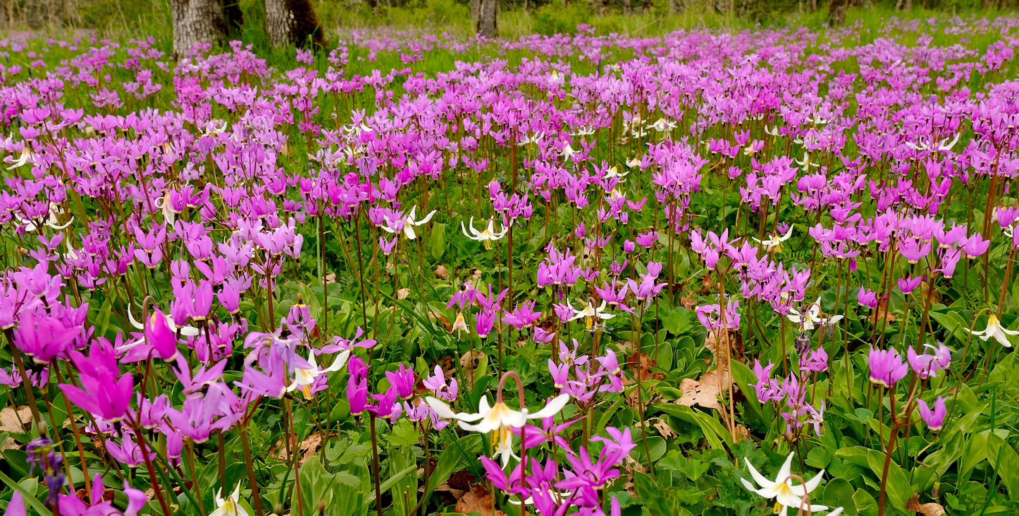
What are the key contents?
Reference Statement;
Statement of Intent;
Significance of the Land and the Amenities;
Current status of the Land as it relates to the Restrictions;
Current status of the Land as it relates to the Reserved Rights;
Acknowledgement of landowner(s) and covenant holder(s) that the BDR is accurate at the date of covenant registration;
Specific;
Measurable.

Slide 7

What are the key procedures?
MUST be completed prior to covenant registration;
MUST be completed by a person knowledgeable about the Lands;
MUST be signed by the author, the landowner and the covenant holder all agreeing that the BDR is an accurate description of the Lands at the time of covenant registration;
Completing BDRs must be a normal practice of your Land Trusts covenant program and enshrined in your Trust’s policies – including written records policies about document storage;
Completing BDRs should be done according to a standard template, as amended from time to time.

Slide 8
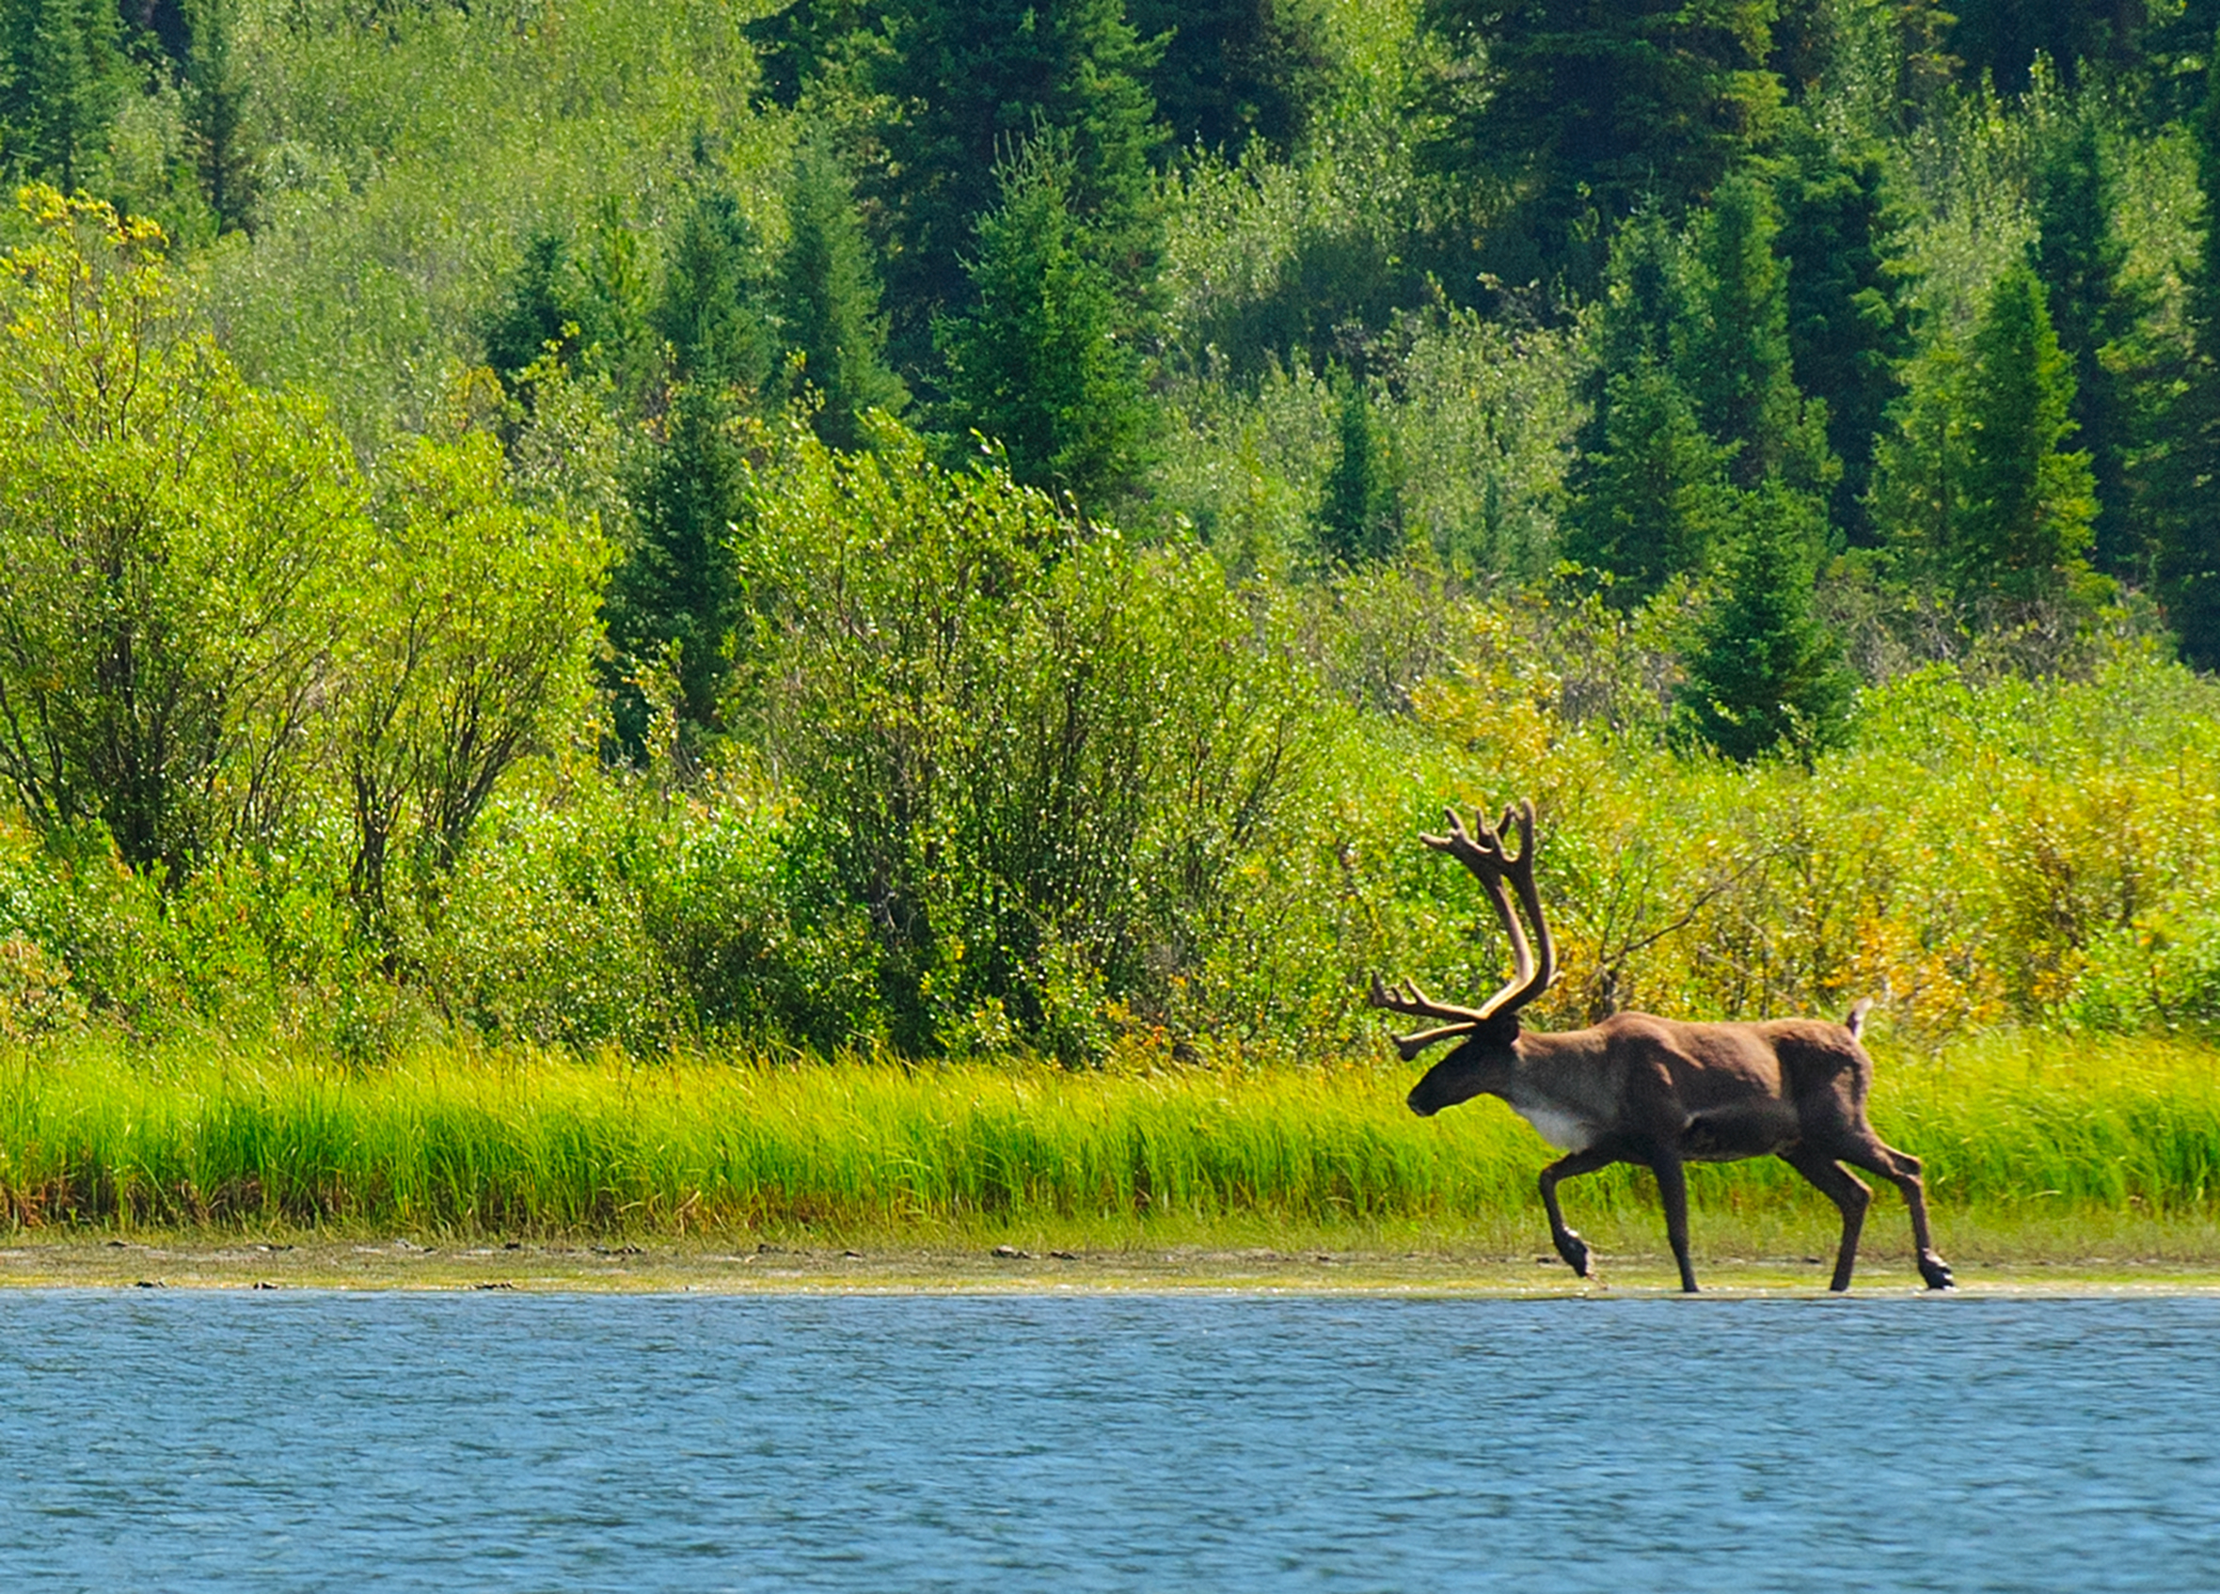
Let’s go look at the new BDR template!

Slide 9

Thank you!
Tim Ennis, President
Latitude Conservation
Solutions Company
250-650-9561

