Slide 1
Commercial General Liability Insurance
Land Trust Alliance of British Columbia

Slide 2
Agenda
What is Commercial General Liability?
What is Covered Under the Policy?
Who is covered?
Policy Exclusions?
Coverage Extensions?
Your duties in the event of a Loss
Ways to Manage Risk and Mitigate Risk
Questions

Slide 3
What is Commercial General Liability?

Slide 4

Protection for Losses that are physical in nature
  Bodily Injury
  Property Damage
Liability arising out of your operations
Defense Costs
Settlement Costs

Slide 5
Policy Coverage
What is covered under the CGL policy

Slide 6

Occurrence Based Policy
Coverage for losses in the policy period

Slide 7
Policy Coverage
Limits of Insurance

Slide 8
Limit of Liability - $5,000,000
Defense Costs Included
$1,000 Deductible
Personal & Advertising Injury
Medical Payments
Tenant’s Legal Liability
Non-Owned Automobile

Slide 9
Policy Coverage
Who is covered under the policy?

Slide 10
Policy Coverage
What is a claim or occurrence?

Slide 11
A request for compensatory damages for Bodily Injury or Property Damage arising out of an occurrence
an occurrence is defined as “an accident, including continuous or repeated exposure to substantially the same general harmful conditions
The occurrence must occur in the coverage territory
The occurrence must occur in the policy period

Slide 12
Policy Exclusions
What is not covered under the CGL Policy

Slide 13
Exclusions for Bodily Injury & Property Damage
Expected or Intended Injury
Contractual Liability
Workers Compensation
Employers Liability
Aircraft or Watercraft
Automobile
Damage to your own property
Electronic Data/Confidential Information
Abuse
Bouncy Castles/Inflatables

Slide 14
Exclusions for Personal & Advertising Injury Liability
Knowingly violation of another’s rights
Knowingly publishing false material
Acts prior to policy period
Criminal Acts
Contractual Liability
Breach of Contract
Failure to conform to Statements
  Performance or Quality of Goods
Wrong description of prices
Copyright, patent, trademark or trade secret infringement
Interactive websites, forums, bulletin boards and chatrooms
Unauthorized use of another’s name
Data Related Liability or Disclosure of personal or confidential information

Slide 15
Exclusions for Medical Payments
Insureds
Hired persons
Injury to people who normally occupy premises
Claims that would be covered under Workers Compensation
Claims due to athletic activities

Slide 16
Exclusions for Tenant’s Legal Liability
Expected or Intended Injury
Contractual Liability

Slide 17
Common Exclusions
Asbestos
Fungi or Spores
Nuclear
Pollution
Terrorism
War Risks

Slide 18
Policy Extensions

Slide 19

Employers’ Bodily Injury Liability Coverage
Employee Benefits Extension
Additional Insured Extension
Legal Liability for Damage to Hired Automobile Extension

Slide 20
What To Do In The Event Of A Loss

Slide 21
Notify insurer of any incident that may result in claim
Notify insurer immediately of any action or notice of claim
Record information about incident
Cooperate with insurer in the investigation and settlement

Slide 22
Claims Examples

Slide 23
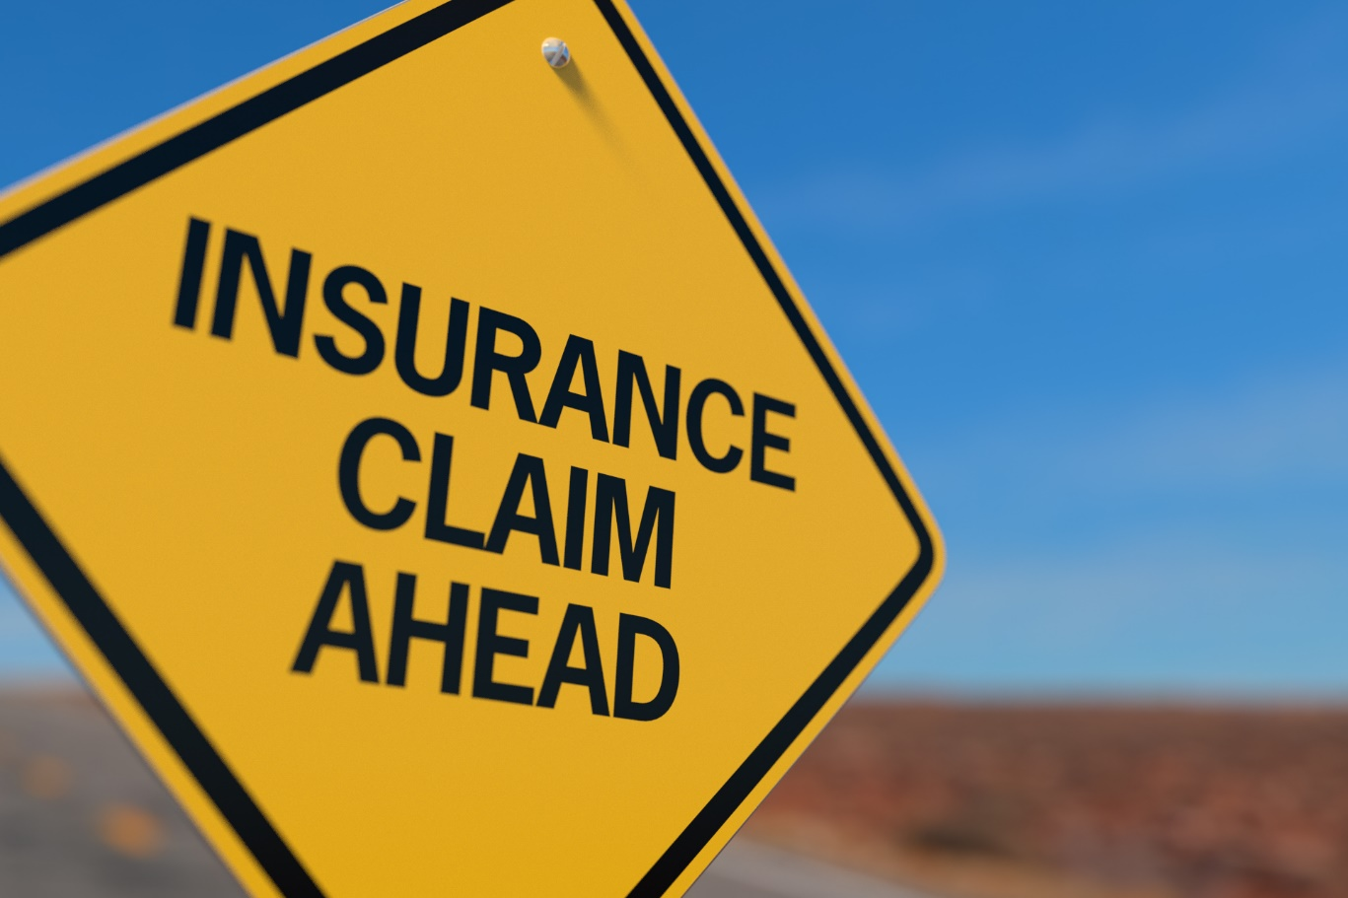
Commercial General Liability
  Bodily Injury
  Property Damage
Medical Payments
Tenant’s Legal Liability
Personal Injury and Advertising Injury
Non-Owned Automobile

Slide 24
Managing Risk

Slide 25
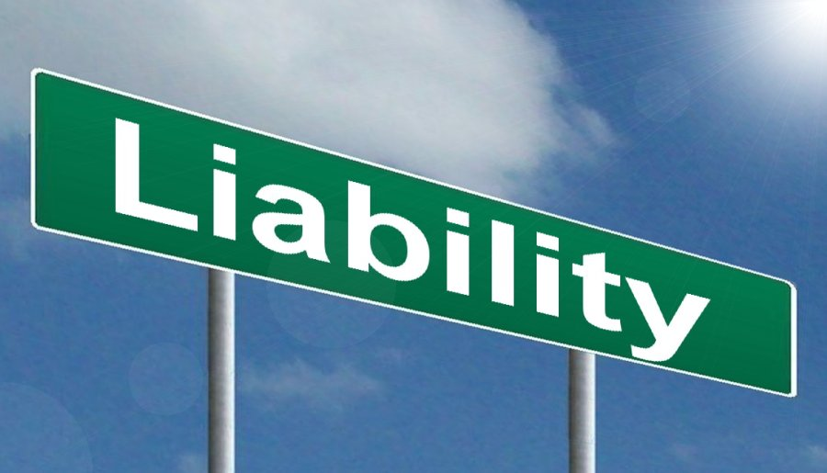
Waivers
Ensuring Environment is Safe
Ensuring Services are Safe
Making sure sub-contractors and contractors are insured
Review your operations and risks associated
Incident Logs/Reports

Slide 26
Questions

Slide 27
Thank you
Heather Anderson, CIP, CRM, CAIB heather.Anderson@megsonfitzpatrick.com
250-940-9101

