Slide 1
A National Conversation
Canadian Land Trust Working Group CLTWG
Wildlife Habitat Canada
National Land Trust Body

Slide 2
A National Conversation
Justin Thompson, Canadian Land Trust Working Group CLTWG
Julia Thompson, Wildlife Habitat Canada
Paul McNair, National Land Trust Body

Slide 3

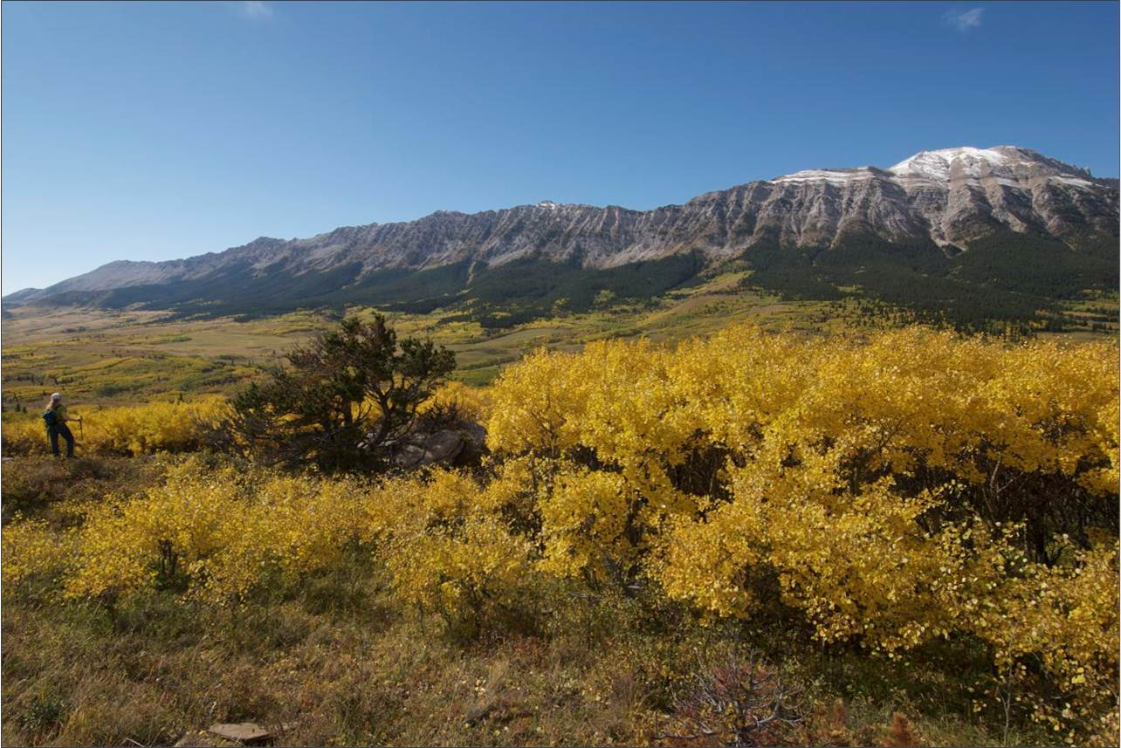
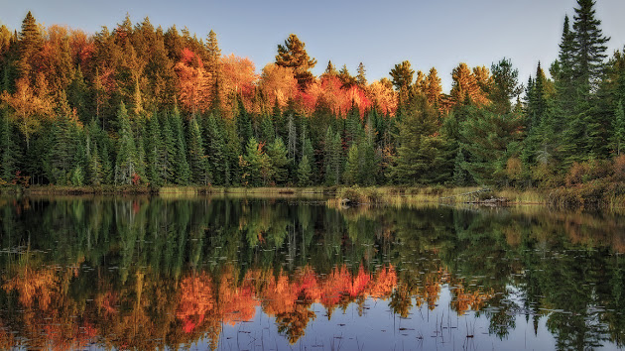
The Canadian Land Trusts Working Group
&
Federal Funding for Community and Regional Land Trusts Across Canada
Presented by
Justin Thompson, Chair of the CLTWG &
ED of the Southern Alberta Land Trust Society (SALTS)

Slide 4
Overview
Who is the Canadian Land Trusts Working Group?
What Have We Accomplished?
Where Are We Going?
What Do We Need From You?

Slide 5
History
The 2014-2019 Natural Area Conservation Plan saw just $5 of $100 million (OQO) directed to community land trusts
When discussion began with ECCC around the Nature Fund and a subsequent NACP program, several land trusts started discussing the need for more funding
A handful of land trusts along with the three provincial associations (BC, ON, QC) started working together to engage ECCC, NCC, and DUC about more dollars for land trusts and a grant program that better served our needs

Slide 6
The Canadian Land Trusts Working Group was formed with the sole focus of providing a unified voice for the sector in discussions with the Federal Government around funding and conservation programs.
It is an ad hoc group with representation from regional and community land trusts in British Columbia, Alberta, Ontario, Québec, Nova Scotia, and Prince Edward Island, and the three provincial land trust associations (BC, ON, QC).

Slide 7
Who Exactly Are We?
While there have been slight changes in composition, the following individuals have dedicated over three years of significant volunteer work to the CLTWG and represent significant regional diversity and differing sizes of land trusts, with the alliances representing all types (from West to East):
Paul McNair – LTABC
Jasper Lament – BC Nature Trust
Justin Thompson – Southern Alberta Land Trust Society
Bill Lougheed – Georgian Bay Land Trust
Susan Walmer – Oakridges Moraine Land Trust
Alison Howson – Ontario Land Trust Alliance
Véronique Vermette – Réseau de milieux naturels protégés
Megan Harris – Island Nature Trust (PEI)
Bonnie Sutherland – Nova Scotia Nature Trust

Slide 8
Successes
Under the recent Natural Heritage Conservation Program (NHCP) through ECCC, the CLTWG, NCC, DUC were able to secure $100 million in funding over 4 years
$20 million ($5MM/year) of this was directed to the Land Trust Conservation Fund (LTCF), effectively quadrupling the funding under the previous program – for which we are very appreciative to ECCC
In addition, Wildlife Habitat Canada was engaged as a partner to deliver the LTCF as the grant administrator rather than NCC which has been very successful

Slide 9
Successes Continued……
The CLTWG worked with WHC and NCC to make numerous changes to the grant program vs the previous OQO program to make it align more with the way we deliver conservation
In addition to the increased funding available, the program changes dramatically increased the interest and demand for the program over the previous OQO program
Wildlife Habitat Canada will summarize in more detail but in its first two years the LTCF has over-delivered on all of its targets

Slide 10
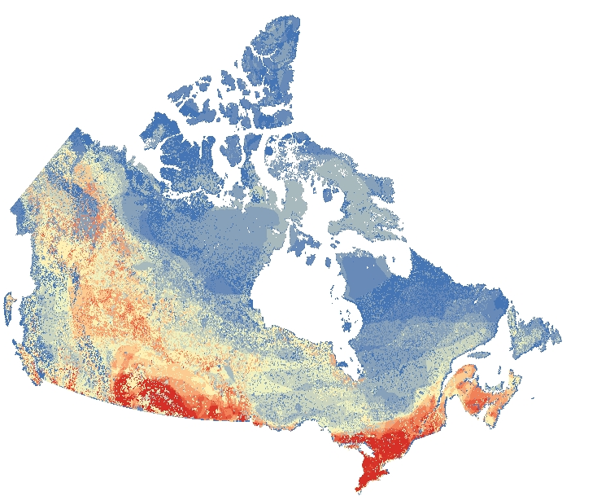
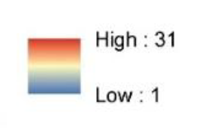
Land Trust Conservation Fund Projects and Species at Risk Density in Canada
In just two years the LTCF has supported all of the projects shown below and has already completed more projects, with more land trusts, in more provinces, on more hectares than the previous grant program
Map provided by WWF Canada showing Number of COSEWIC – assessed at risk species: Terrestrial Analysis of Ecological Representation April 2019

Slide 11
Next Steps
The CLTWG wants to maintain the momentum and continue to see land trusts across Canada partner with the federal government to deliver on critical conservation objectives
We need to strengthen our unified voice and demonstrate the collective value our organizations are providing
We must take the CLTWG from an “ad hoc” group and formalize its governance structure and representativeness
This will give the land trust sector more legitimacy in discussions with governments and other partners

Slide 12
What We Need From Land Trusts
The CLTWG alongside the provincial land trust alliances will begin engaging the sector shortly on what a new “national voice” for land trusts could look like
There has been national land trust organization in the past (CLTA) and there were significant discussions about a new organization in recent years that weren’t finalized
The work of the CLTWG, has created enormous trust and learnings among LT organizations and alliances across the country

Slide 13
What We Need Continued….
Because of the trust developed, we are in a better position than ever to solidify a new national voice for land trusts
This new organization should be focused on community and regional land trusts because our interests and needs are very different than large national organizations
We need your engagement and input to make this new organization a success
This work and LT support is urgent as we need to set the sector up for success in the upcoming discussions with the federal government around programs and funding

Slide 14
Community and regional land trusts are making a significant & unique contribution - we need to do more!
Our focus is not just hectares (although the LTCF program will deliver more than 10,000 ha in protection), but the most important hectares:
Habitat for species most at risk in southern Canada
Nature and its ecosystem services close to urban areas
Watershed protection where the most Canadians need it
Community engagement in conservation
Let’s work together to increase our collective capacity and impact because Canada needs the good work that we do!

Slide 15
Thanks!
Comments/Questions?

Slide 16
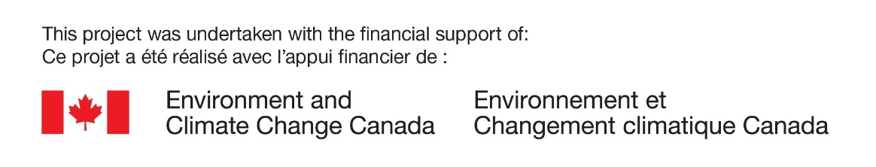
Natural Heritage Conservation Program:
Land Trusts Conservation Fund
(LTCF)
Achievements to date and Year 3 update

Slide 17
Land Trusts Conservation Fund (LTCF)
What is the LTCF?
Goals of the LTCF
COVID-19 Impacts
Where we are
Where we’re going / What’s next
Project Streams
Capacity Building Services
Year 3 – What’s new?
Large Grant Projects Year 3
Small Grant Projects Year 3
How to Apply

Slide 18


What is the LTCF?
NHCP = $100M investment over 4 years by the Government of Canada as part of Budget 2018’s Nature Legacy Initiative.
  The LTCF is a component of the NHCP, providing funding to support Canadian land trusts in securing private lands and private interests in lands.
Goals of the NHCP:
  secure 200,000 hectares towards Canada Target 1
  Protect habitat for the recovery of species listed under SARA
NCC, DUC, WHC and regional and local land trusts represented by the Canadian Land Trust Working Group are working together under the NHCP to support these goals.
Canadian Land Trusts Working Group*
* Representation from regional and community land trusts from the provinces of British Columbia, Alberta, Ontario, Québec, Nova Scotia and Prince Edward Island, and 3 provincial alliances (the Ontario Land Trust Alliance, Réseau de milieux naturels protégés, and the Land Trust Alliance of British Columbia)

Slide 19
Goals of the LTCF
Secure at least 10,000 hectares of land under the program.
  Land that be counted towards Canada Target 1
  High conservation value land
  Habitat for Species at Risk
Achieve a minimum: 1.5:1* in match funding.
  *Requirement reduced from the 2:1 required in Years 1 and 2 of the program.
Engage as many land trusts as possible.
Geographic distribution of funds across Canada.

Slide 20
COVID-19 Impacts
WHC survey - primary LT concerns in next 1-2 years:
  Fundraising (activities and events)
  Project funding (Foundations, granting organizations)
Note: Canadian federal government contributions cannot be used as matching funds under the LTCF program, including COVID-19 federal subsidies (such as the Canadian Emergency Wage Subsidy).

Slide 21
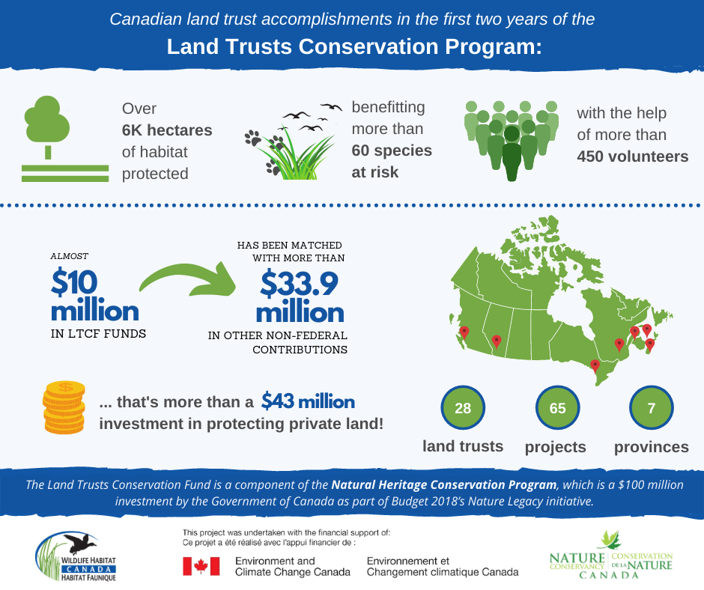
Where we are:
Where
we are:

Slide 22
Where we’re going / what’s next
Year 3
(2021-2022):
Secure at least 2,500 hectares.
Achieve a minimum 1.5:1 in match funding.
Continue to engage new land trusts.
Geographic distribution of funds across Canada.
Year 4
(2022-2023):
Secure at least 2,500 hectares.
Achieve a minimum 1.5:1 in match funding.
Continue to engage new land trusts.
Geographic distribution of funds across Canada.
We are looking for:
Projects that can deliver high conservation value hectares that contribute to Canada Target 1.

Slide 23
LTCF: Project Streams
LARGE GRANT PROGRAM
LTCF funding request up to $1M
Securement and associated costs eligible
FS / CA / combo
YR 3 – Application deadline: March 19, 2021
SMALL GRANT PROGRAM
LTCF funding request of up to $30K (min $5K)
Program design under construction
YR 3 – late Spring 2021 program launch
Eligible Projects:
must close between April 1, 2021 and December 15, 2021;
will have eligible project expenses that will be incurred between April 1, 2021 and March 31, 2022;
must be able to demonstrate a minimum 1.5:1 match* for LTCF funds.
*Matching funds include expenses associated with the project that have been incurred between April 1, 2019 and March 31, 2022 (3 FY period).

Slide 24



LTCF Capacity Building Services
The Provincial Alliances are working collectively to provide capacity building services to support land trusts in successfully engaging with the LTCF by:
  assisting land trusts in adherence to Canadian Land Trust Standards and Practices 2019; and,
  providing technical support to land trusts with regards to LTCF priorities such as conservation planning, Pathway to Target 1, record keeping, and land management.
Please note that WHC is the primary contact for all general program inquiries regarding program eligibility and guidelines.

Slide 25
YR 3 LTCF – What’s New?
LARGE GRANT PROGRAM (2021-2022)
Guidelines launched late January 2021
Application window opened on February 26, 2021.
Deadline to apply is March 19, 2021.
  Award notifications mid-May 2021.
Reduced matching funds requirement (1.5:1)
Mid-project milestone dates
Simplified lease expense calculation
SMALL GRANT PROGRAM (2021-2022)
Program design under construction.
Launch anticipated late Spring 2021.

Slide 26
LTCF: Large Grant Projects Year 3
YR 3 – Application deadline: March 19, 2021
Max. of 3 Applications per LT
  Total ask of up to $1M
  Minimum ask of $30,001
Eligible Project Types
  Acquisition of Fee Simple Lands;
  Conservation Agreements; or
  Combination thereof
Evaluated on:
  Conservation and biodiversity significance
    Species at Risk
  Connectivity/adjacency to other conservation lands
  Project resiliency
  Conservation co-benefits
Required:
  Matching Funds*
  *Reduced requirement in YR 3 to 1.5:1
  Stewardship Endowment Funds
  Conservation Plan/Rationale
  Baseline Documentation Report
  (Conservation Agreements only)
  Financial Project Audit
  (final reporting)

Slide 27
LTCF: Small Grant Projects Year 3
YR 3 – Anticipated launch late Spring 2021 *
Eligible funding requests:
  Minimum ask of $5,000
  Maximum ask of $30,000
Eligible Project Types
  Acquisition of Fee Simple Lands;
  Conservation Agreements;
  Combination thereof (being considered for addition in YR 3 program design)
Application Evaluated on:
  Eligibility and completion
  First come, first served
Required:
  Matching Funds*
  *Reduced requirement in YR 3 to 1.5:1
  Stewardship Endowment Funds
  Conservation Plan/Rationale
  Baseline Documentation Report
  (Conservation Agreements only)
  * Program design under construction, for consideration of land securement as eligible expense for LTCF funds in YR 3 and YR 4.

Slide 28

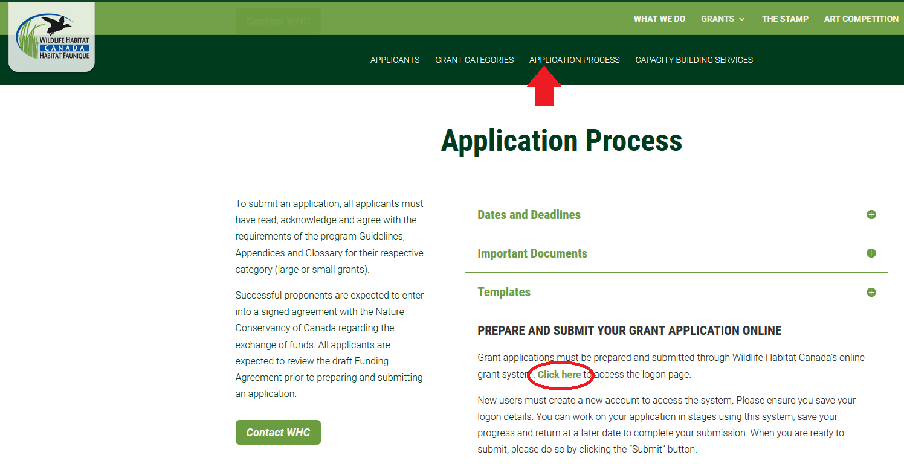
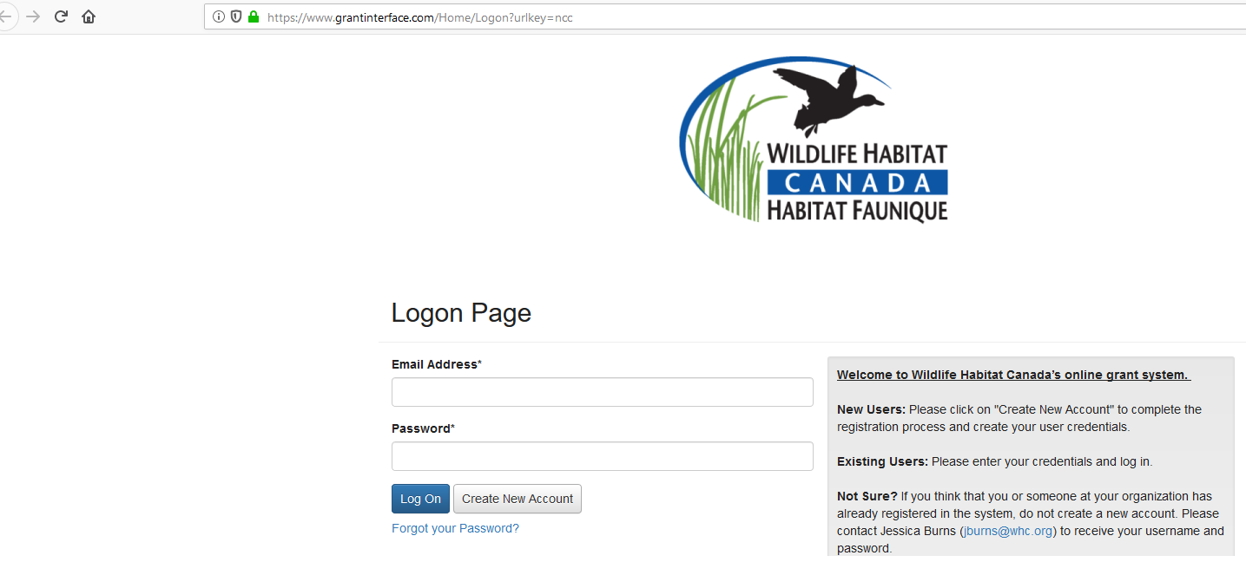
How to Apply
1
Visit Wildlife Habitat Canada’s website:
    www.whc.org/ltcf
  Review dates, deadlines and important documents
  Access Online Grant Application System
  New applicants: create a login
  Returning applicants: use your Year 1 or 2 login
  NOTE: please review your application carefully before submitting. Failure to upload the correct, requested documentation may result in an application being deemed incomplete and disqualified from funding consideration.
2
3

Slide 29
Thank You!
Merci!

Slide 30
A New National Body
For Canada’s Community-based land trusts

Slide 31
Update on discussions
CLTWG, Alliances, S&P discussions, LTCF have encouraged dialogue between levels of organizations and geographic representation
Fall 2020 a working group was established:
Renata Woodward, New Brunswick Nature Trust
Veronique Vermette, Reseau des meilleurs protégé
Alison Howson, Ontario Land Trust Alliance
Greg Wickware, Ontario
Paul McNair, LTABC
Outcome to present recommendations to CLTWG and 3 Alliances on a partnership model to create a national body

Slide 32
National discussions
Discussions have resulted in a model that supports:
Land trusts continuing their work at the community with no added bureaucracy
Alliances continue to support member land trusts provincially with some expanded efforts to land trusts currently without a provincial Alliance
A National Organization that support Alliances as stakeholders.
This streamlined approach would see a national organization focus on areas such as:
Federal funding
National advocacy
Projects identified by stakeholders as mutually beneficial in an effort to reduce duplication ( national legal defense fund, national communications, national conference)

Slide 33
National Discussions
Input will be sought from CLTWG, Alliances and land trusts in the coming weeks
New national initiative!
www.ltacanada.ca
a new national website for land trusts in Canada!

