Slide 1
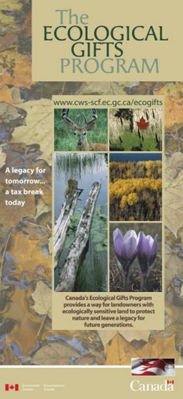



Canada’s ecological gifts program:
Income Tax Benefits for Protecting Your Land
David Cunnington
Canadian Wildlife Service
February 2020

Slide 2
What is the Ecological Gifts Program?
A federal tax incentive program
that offers
income tax benefits to
private and corporate landowners
who donate
ecologically sensitive lands and
partial interests in lands
to qualified recipients
Notes:
This slide covers 90% of the program.
The Ecological Gifts Program is an income tax benefit program administered by Environment Canada under the Income Tax Act of Canada.
The Ecological Gifts Program is…[Read from slide]…
The EGP provides favorable tax treatment for donations of conservation lands, whether they be partial interests, such as a conservation covenant, donations of fee simple title, or partial donations. All are possible as long as they meet the criteria of the program that we will review shortly….

Slide 3
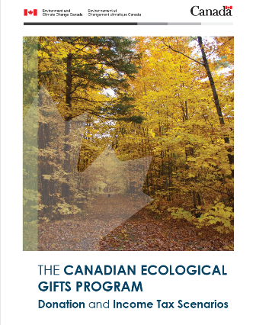
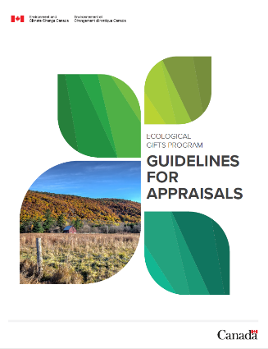
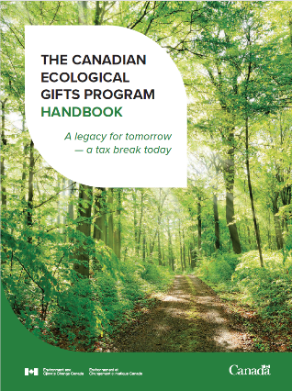
EGP Update
Notes:
EGP= A way to protect ecologically sensitive land on private property. Non-regulatory (more efficient use of resources); voluntary and flexible;

Slide 4

EGP Update
Updated publications
Tax for unauthorized change in use or disposition
Gift Survey
Island Trust Conservancy’s 25th ecogift

Slide 5
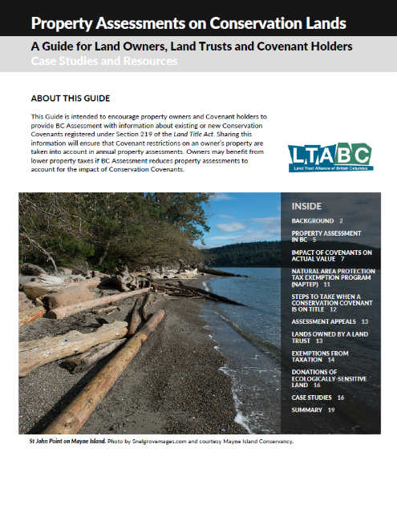
Property Assessments on Conservation Lands

Slide 6
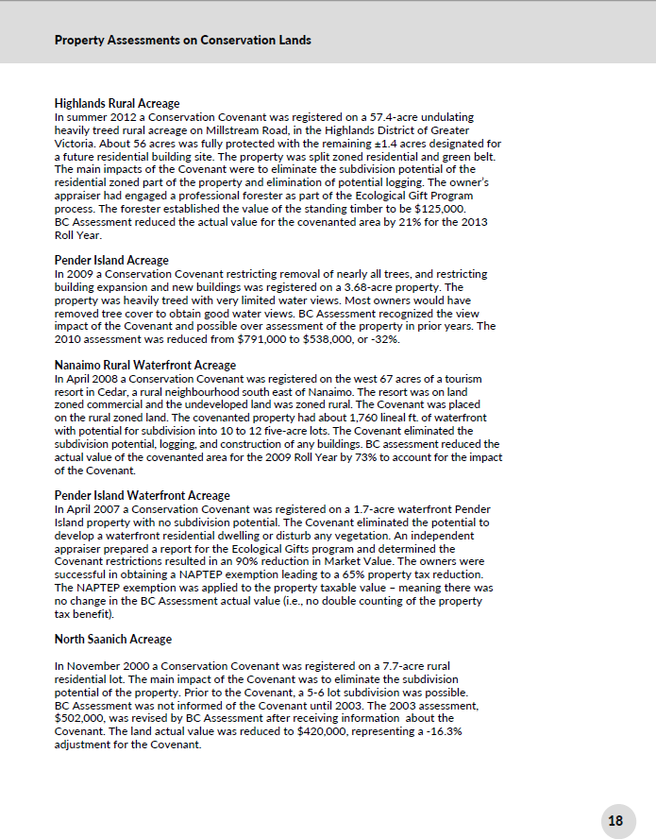
Property Assessments on Conservation Lands

Slide 7

Resources
Key publications:
  Brochure
  Handbook
  Donation and Tax Scenarios
  Engaging an Appraiser
  Application form
  Disposition or Change in Use - What Recipients Need to Know
Ecological Gifts Program Website
BC coordinator: David.Cunnington@canada.ca,
cell: 604-329-7716
Notes:
At a minimum, here is what you need to project manage a donation for a client

