Slide 1
Conservation in a changing landscape: An overview of land trusts in Canada
Karen Kalynka, MA
In collaboration with:
Paul McNair (BC Land Trust Alliance)
Jessica Dempsey (UVIC)

Slide 2
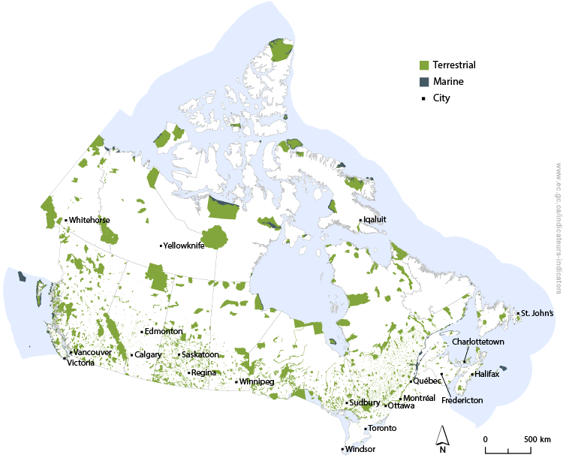
Islands of Green: Protected Areas in Canada
Commitment to protect
17 % to reach the 2020 Biodiversity Goals and Targets
10% of Canada’s terrestrial land mass is protected

Slide 3
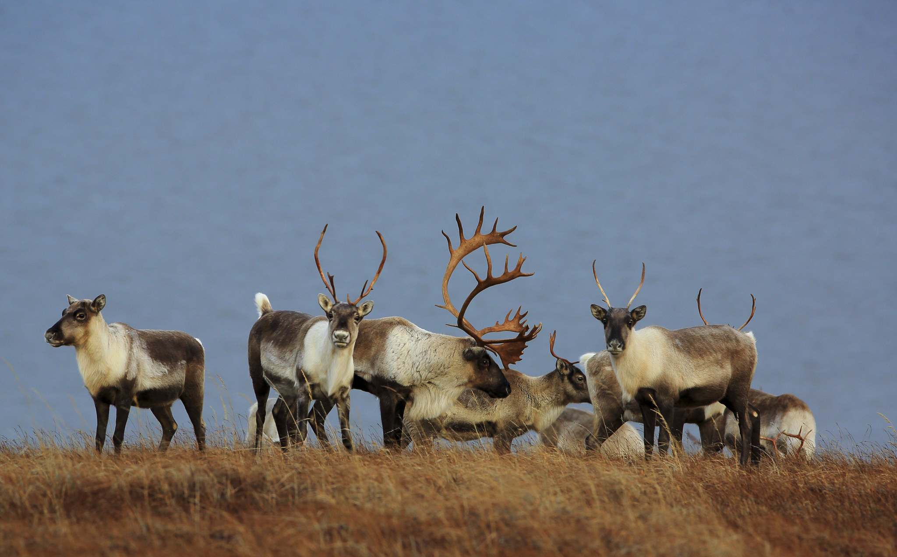
Private land conservation is important
11% of Canada is privately owned
primarily in Southern regions
Habitat loss is the largest factor contributing to Species at Risk:
    46% from Agriculture
    44% from Urbanization

Slide 4
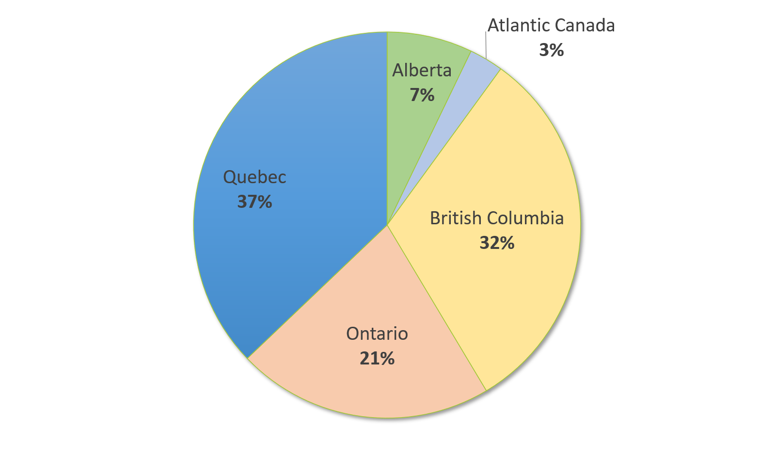
About this research (the survey)
According to Wilkinson (2014), 200 Land Trust Organization exist in Canada
Survey invitation sent to 120 members of the Alliances; 114 were initiated online
70 (bilingual) anonymous online surveys were completed between Sep-2016 and July-2019 (N=70)
What is the current state of Land Trusts in Canada in relation to size, level of protection, funding, governance structure and ecological monitoring?
Home Province of the Land Trusts included in this sample (N=70)

Slide 5
What is the current state of Land Trusts in Canada (N=70)?
1. Who are the Land Trusts
2. What and how do they protect
3.
Funding & revenue
4. Standards and Practices
Challenges
Opportunities
Findings:

Slide 6
Who are the land trusts?
In this section:
  mission statement + strategic plan
  staff + volunteers
  First Nations
  measuring success

Slide 7
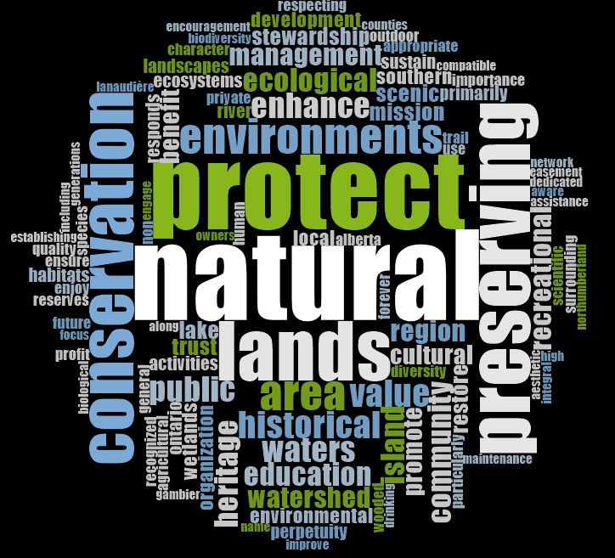
Who are the Land Trusts
Mission Statements
(word Cloud of 300 most common words)

Slide 8
Who are the Land Trusts
Mission & Strategic Plan
Is there a Strategic Conservation Plan articulated and in place (n=65)?
What defines the mission statements (n=67)?
  protect natural environment
  conserve ecological, scenic, cultural, geological, or recreational value
  conservation in perpetuity
  Public Benefit

Slide 9
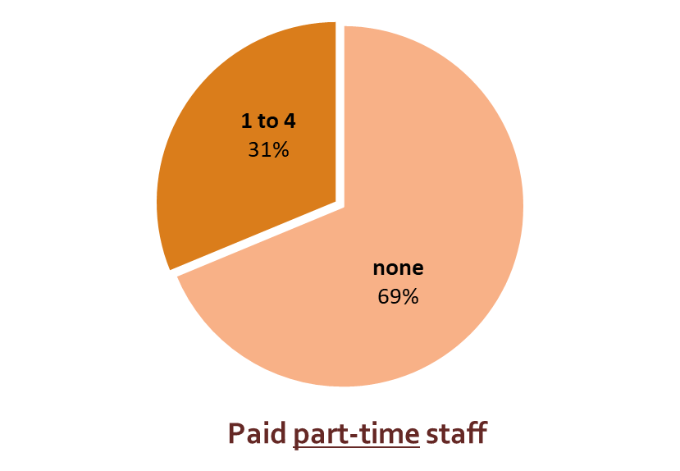
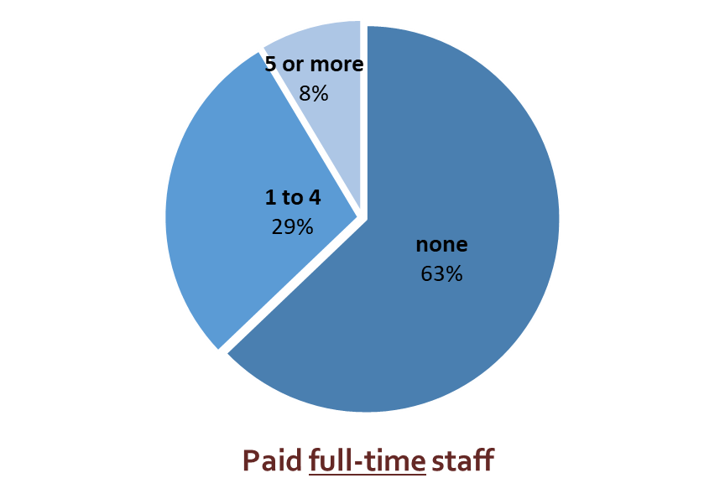
Who are the Land Trust
Staff and Volunteers (n=65)
Volunteers are the driving force:
organizations have on average 50 volunteers that they work with
organizations have on average 9 (volunteer) board members
volunteers are recruited primarily by
  word of mouth (members)
  special events
  website / social media
recruitment of volunteers is a constant process
Notes:
Their strength is the willingness of the people to protect areas, which in turns sets an example for the government for follow.

Slide 10
Who are the Land Trust
Partnerships with First Nations
Education
Partnerships and participation in site-specific projects (restoration activities)
Process of consultation and recognition
Volunteers
Organization’s relationship with First Nations (n=66)

Slide 11
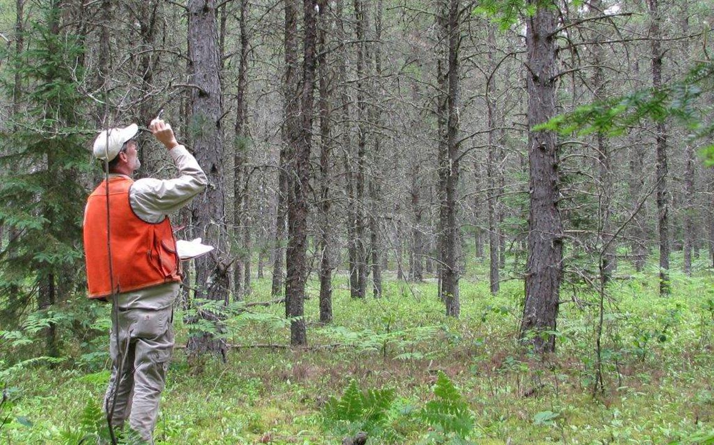
Who are the Land Trust
How is success measured?
by total acres of protected land
number of volunteers
effective monitoring and protection
education, outreach & community/landowner support
financial security
a successful ‘Management and Stewardship Plan’
© brainerddispatch.com

Slide 12
What do the land trust organizations protect, and how do they do it?
In this section:
  what is protected
  how much is protected
  ownership + change
  conservation tools
  monitoring

Slide 13
What do they protect and how
What do the organizations protect (n=66)?

Slide 14
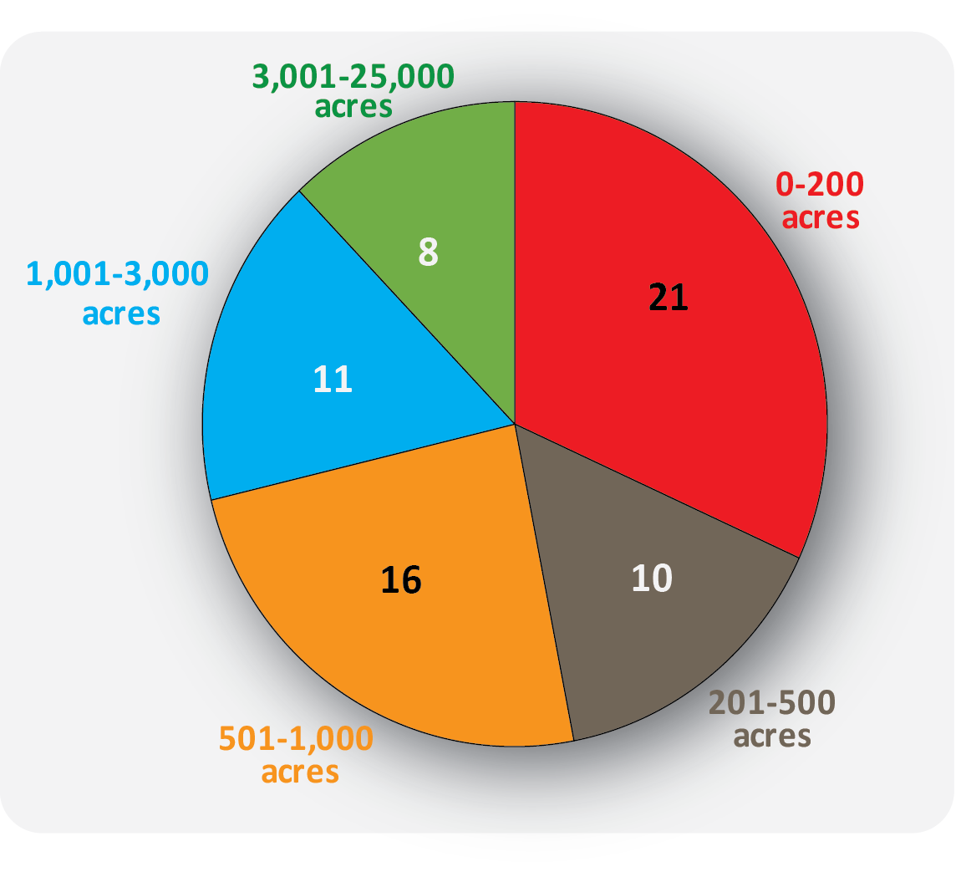
What do they protect and how
How much is protected?
70 organizations:
  median is 531 acres
  (max. 23,639 acres, min. 4 acres)
average of property that is reported as ecologically sensitive is 85% (n=53)
Landscape-scale approach
79% of the Land Trusts collaborated with other organizations to create connected ecological networks using a landscape-scale approach (n=66)
n=66
Notes:
Need to add number of acres protected

Slide 15
What and how they protect
Conservation options used (n=67):
Change in protected areas over the last five years | increased | the same | decreased
Conservation easements/covenants | 52% | 48% | 0%
Fee simple acquisitions | 59% | 40% | 2%
Management agreements | 20% | 77% | 2%
Stewarding agreements for other organizations | 24% | 76% | 0%

Slide 16
What do they protect and how
Challenges:
How is the ability to monitor the protected areas impaired (n=67)?

Slide 17
What do they protect and how
Monitoring (n=42)
monitoring tools used include:
  baseline inventory
  presence/absence surveys
  inventory count
around 50 percent are using biologist or expert naturalists to gather monitoring information
volunteers and land owners provide inventory and monitoring support

Slide 18
Funding & revenue
In this section:
  revenue origins
  Ecological Gift program
  business + charity + endowments, etcetera

Slide 19

Approximately how much of the revenue that is received comes from the following sources? (N=70)
 | none | Very little | Somewhat | Quite a Bit | A Great Deal | Almost All | not reported
individual donors and member dues | 0% | 42% | 15% | 3% | 3% | 24% | 12%
local government | 36% | 33% | 12% | 6% | 3% | 6% | 3%
federal funds | 33% | 33% | 15% | 6% | 9% | 0% | 3%
private foundations | 30% | 30% | 24% | 3% | 0% | 0% | 12%
charities & non-profits | 39% | 45% | 3% | 3% | 0% | 0% | 9%
provincial funds | 39% | 39% | 12% | 0% | 0% | 0% | 9%
grants from private businesses | 21% | 67% | 3% | 0% | 0% | 0% | 9%
income from investments | 24% | 61% | 0% | 0% | 0% | 0% | 15%

Slide 20
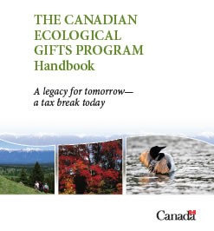
Funding/ revenue
Ecological gift program
66 percent (n=61) indicated to have used the program
General comments:
  good program, used when it benefits the landowner
  tedious: time consuming & expensive process
  small-sized land trusts do not have the capacity to promote it (to landowners)

Slide 21
Funding/ revenue
  12% of the organizations operate a business as part of their organization (n=59)
  93% operate as a charity (n=59)
  18% of the sample uses debt/credit as a financial tool (n=55)
  68% own endowments (n=55) and 39% say they have an endowment policy in place (n=33)
  12% of the sample have a legal defense fund (n=42)
  7% has a deficit (n=55)

Slide 22
Standards and Practices
In this section:
  support for the S&P
  comments on the accreditation

Slide 23
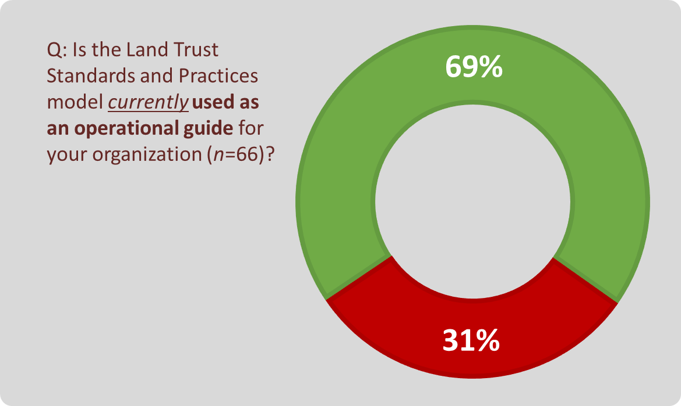
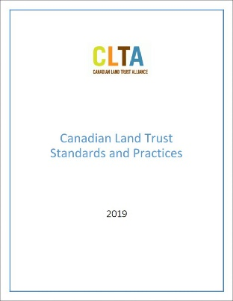
Standards and Practices
Standards and Practices Model

Slide 24
Standards and Practices
Standards and Practices Model
overall comments were positive about using the Model
  standardize conservation–legally and financially
  credibility (donors, partners, public)
concerns about making the Model mandatory
  difficult for small or new organizations to implement
  fear that the model might be to inflexible to their needs
  wary about mandatory enforcement

Slide 25

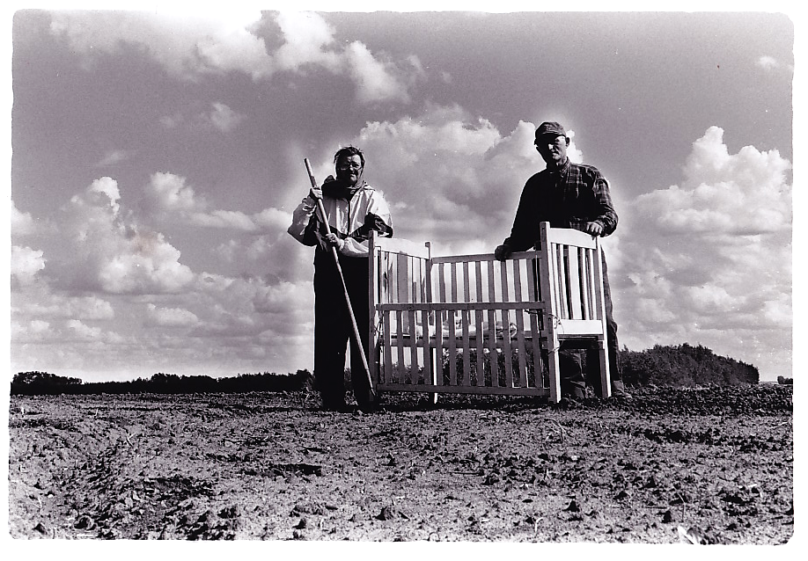



Thank You

Slide 26


